Slide 1
IBM Rational Functional Test

Slide 2








About CloudThat​
9+
350k+
100+
100+
350+
Years in Business
Professional Trained
Corporates Trained
Projects Delivered
Cloud Certifications
Leader in Training and Consulting on Cloud, Security, AI/ML, IoT and DevOps
Trained over 350k+ professionals across technologies and geographies
Proven track record of training delivery for all stages of employee lifecycle
Strong team of 125+ certified cloud experts with
industry consulting experience
Robust consulting division brings industry prospective to training delivery
Page 2

Slide 3
PREREQUISITES:
Manual Testing
Java Knowledge

Slide 4
IBM Rational® Functional Tester
What is IBM RFT ?
IBM Rational® Functional Tester is an object- oriented automated testing tool that lets you test a variety of applications.
You can quickly generate scripts by recording tests against an application, and you can test any object in the application, including the object's properties and data.

Slide 5
Testing applications based on different environments like
HTML
SAP
HTML 5
Silverlight
Java
Windows
.NET
Visual Basic
Eclipse
Siebel
Flex
Ajax

Slide 6
Integrations with Other Tools
IBM Rational Quality Manager
Test Management tool
IBM Rational Team Concert
Change and Configuration management tool
IBM Rational Test Workbench
IBM Rational ClearCase
IBM Rivoli
HP ALM/QC (Application Lifecycle management, Quality Center)
Jenkins
Ant
etc

Slide 7
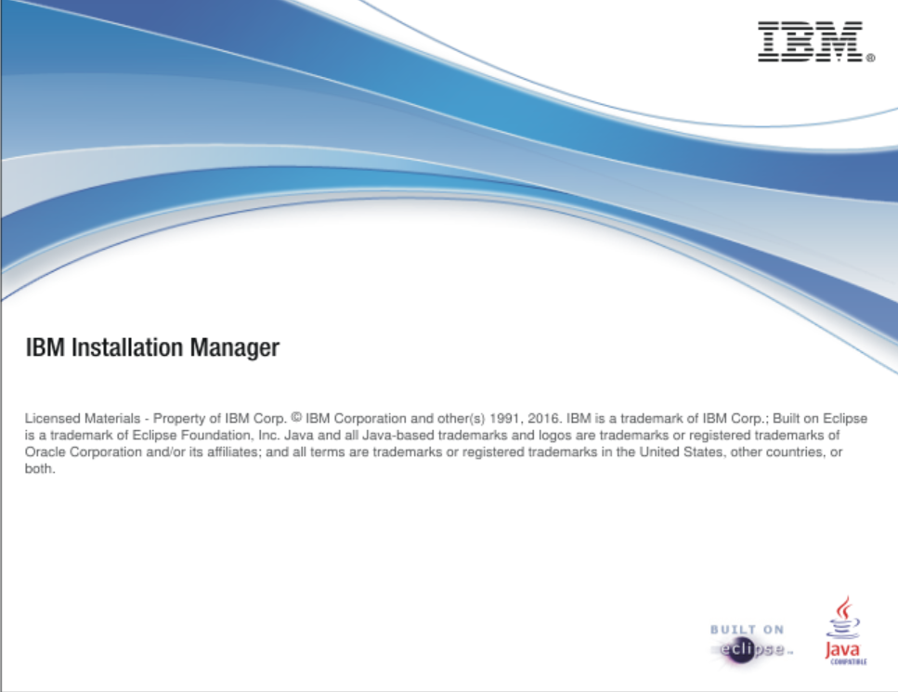

Slide 8
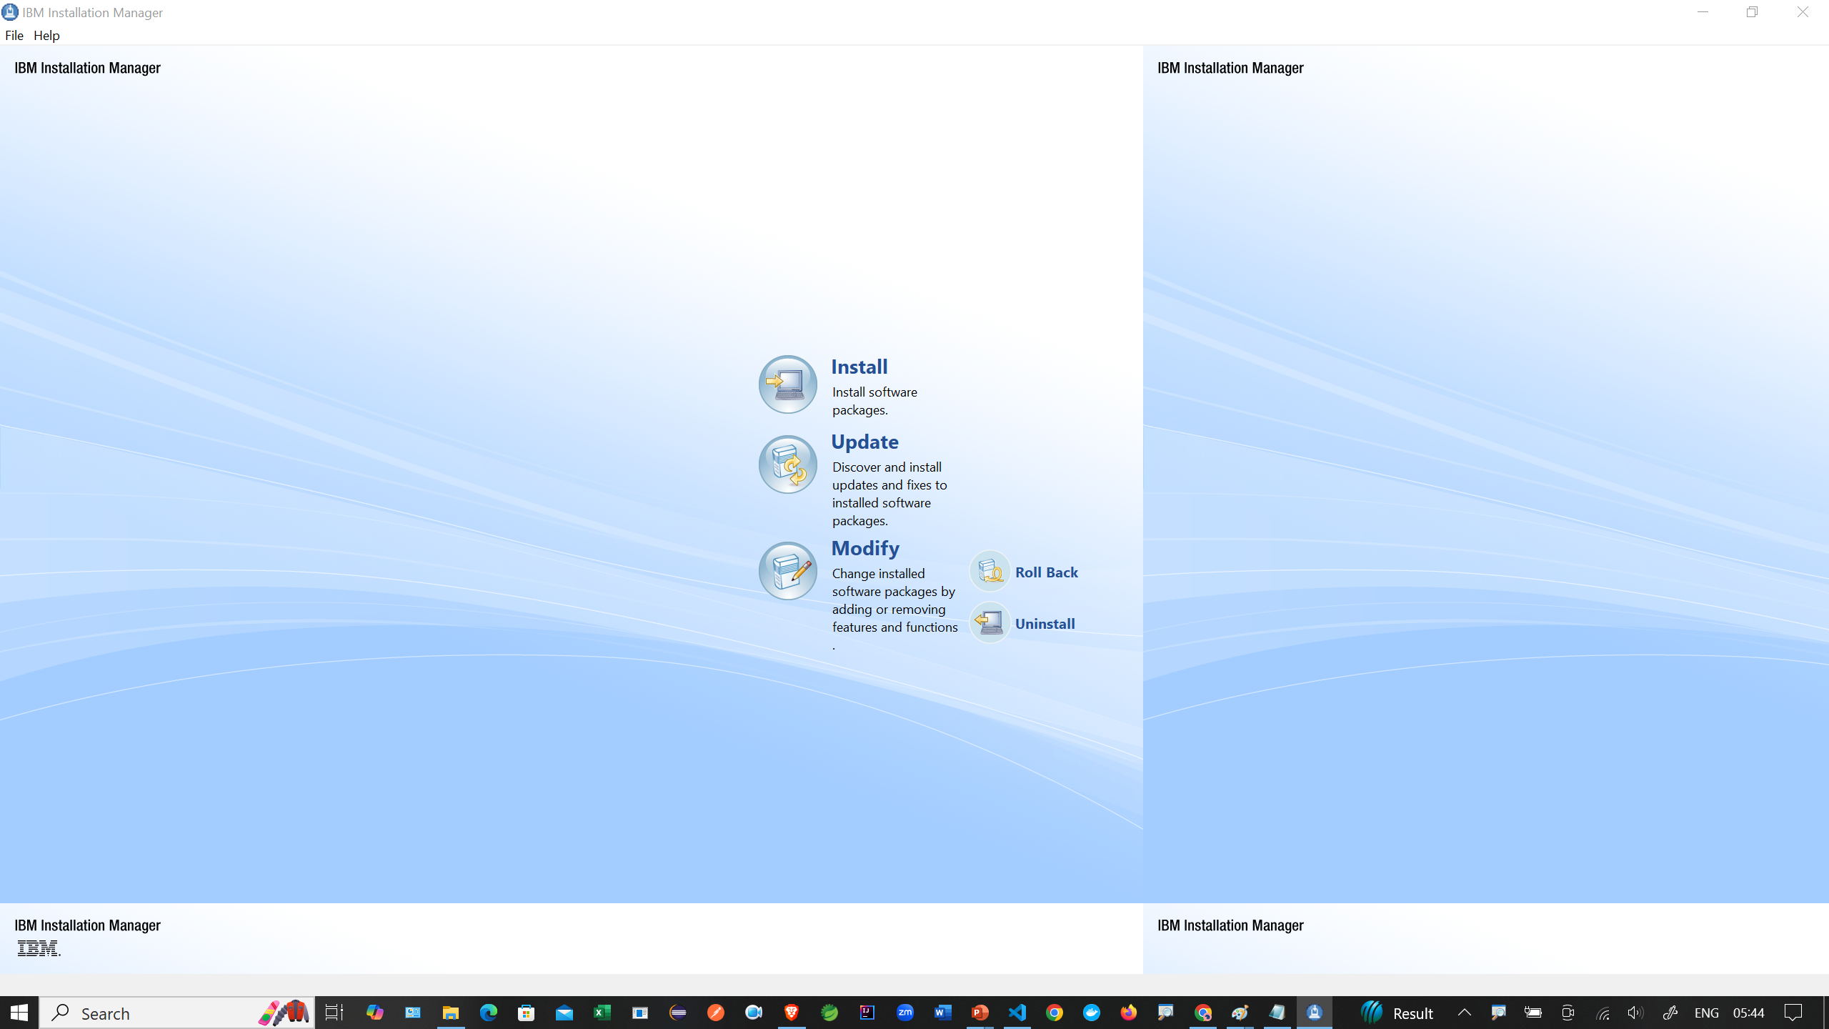

Slide 9
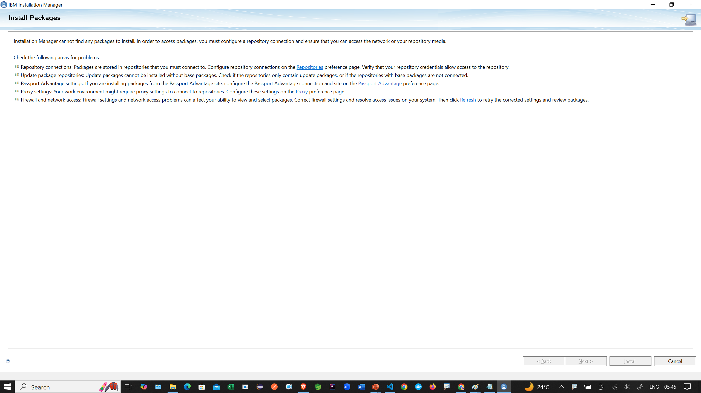

Slide 10
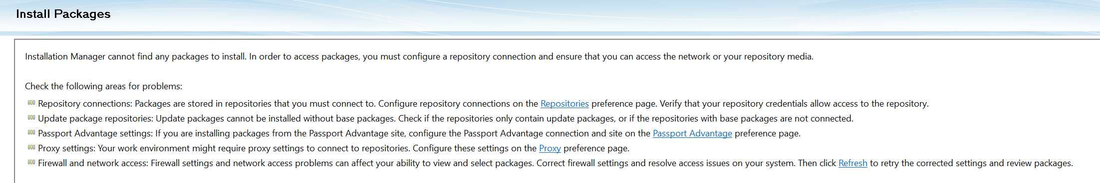

Slide 11
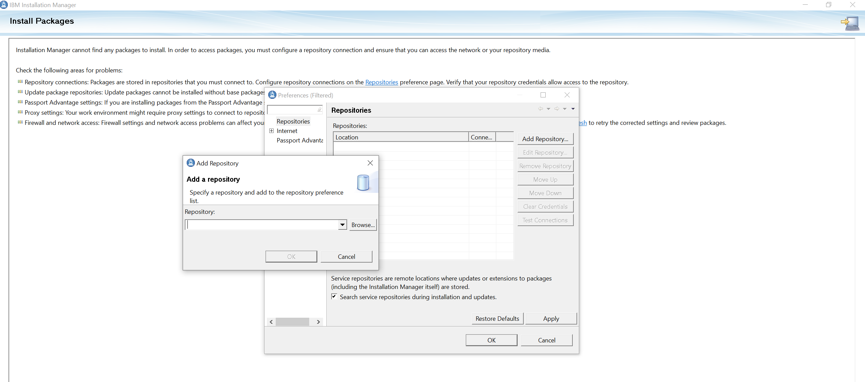

Slide 12
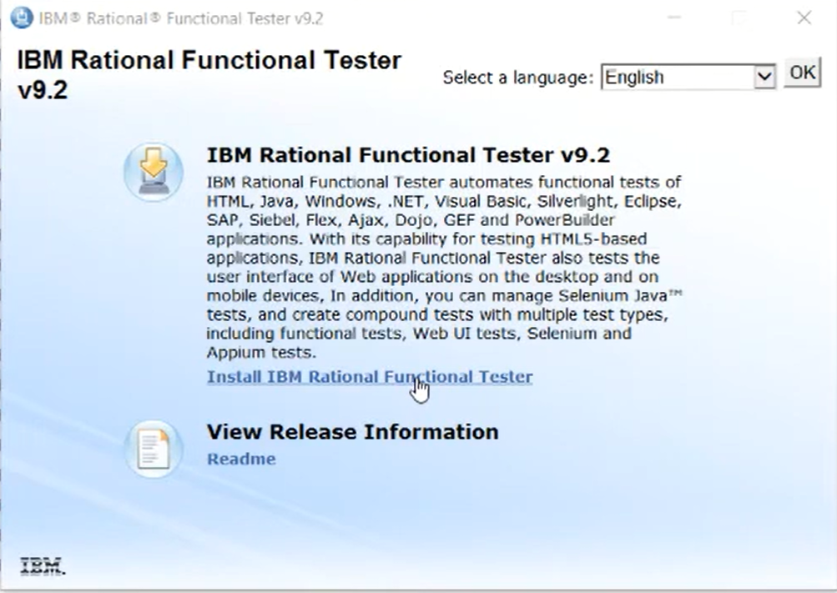

Slide 13
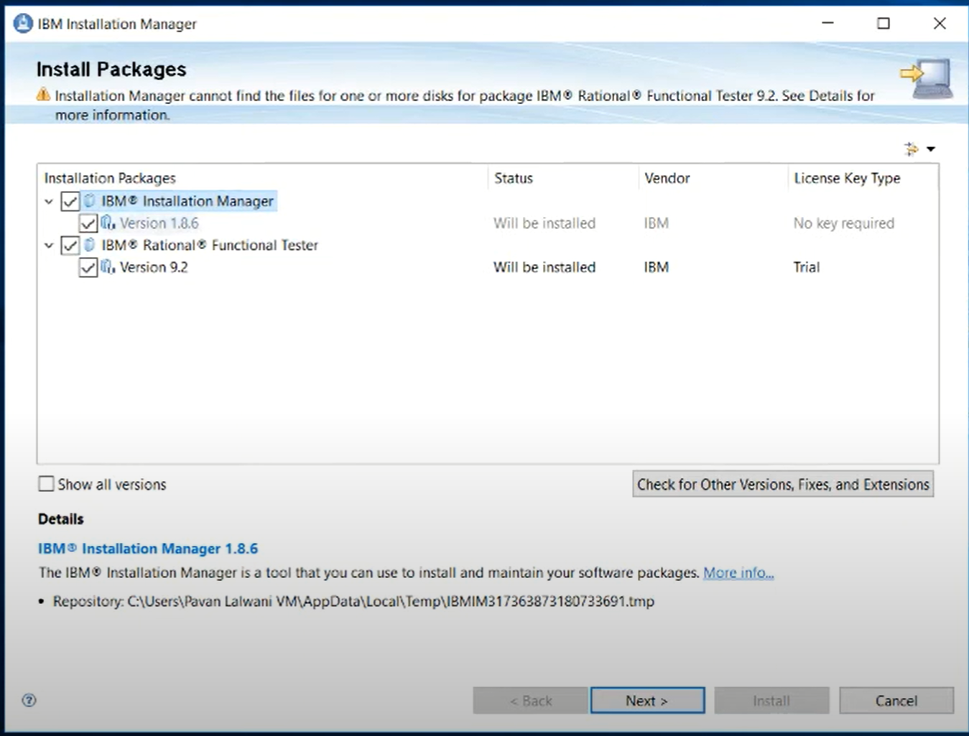

Slide 14
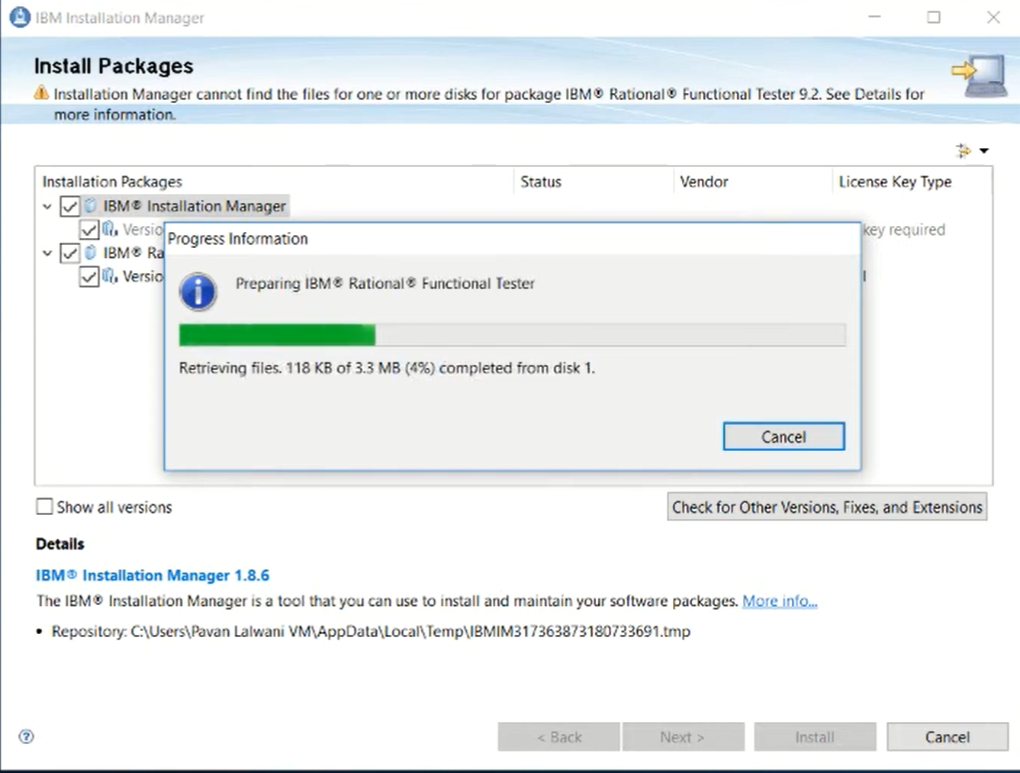

Slide 15
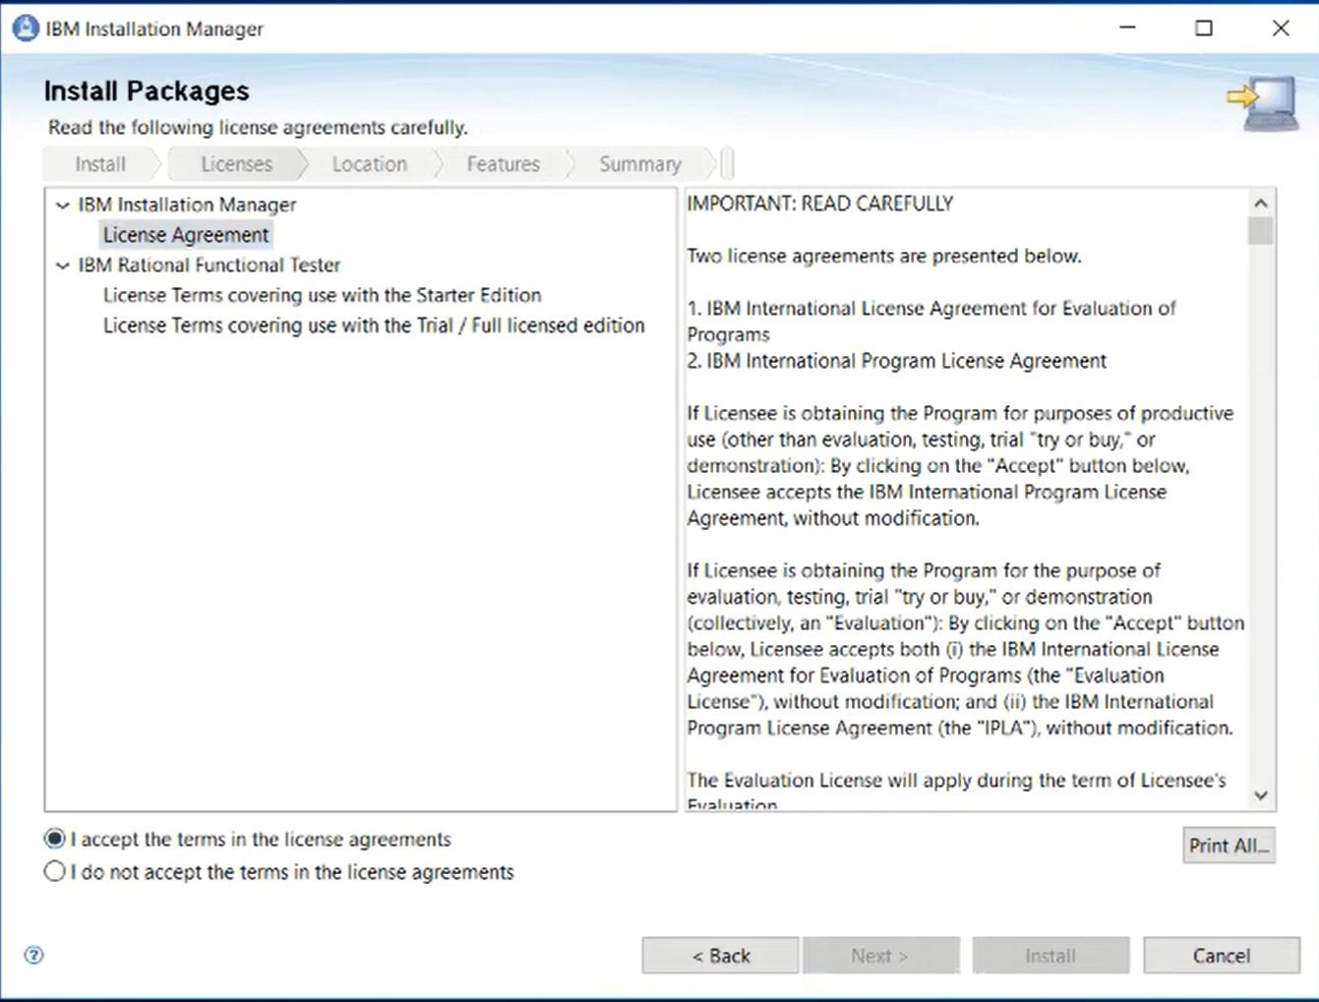

Slide 16
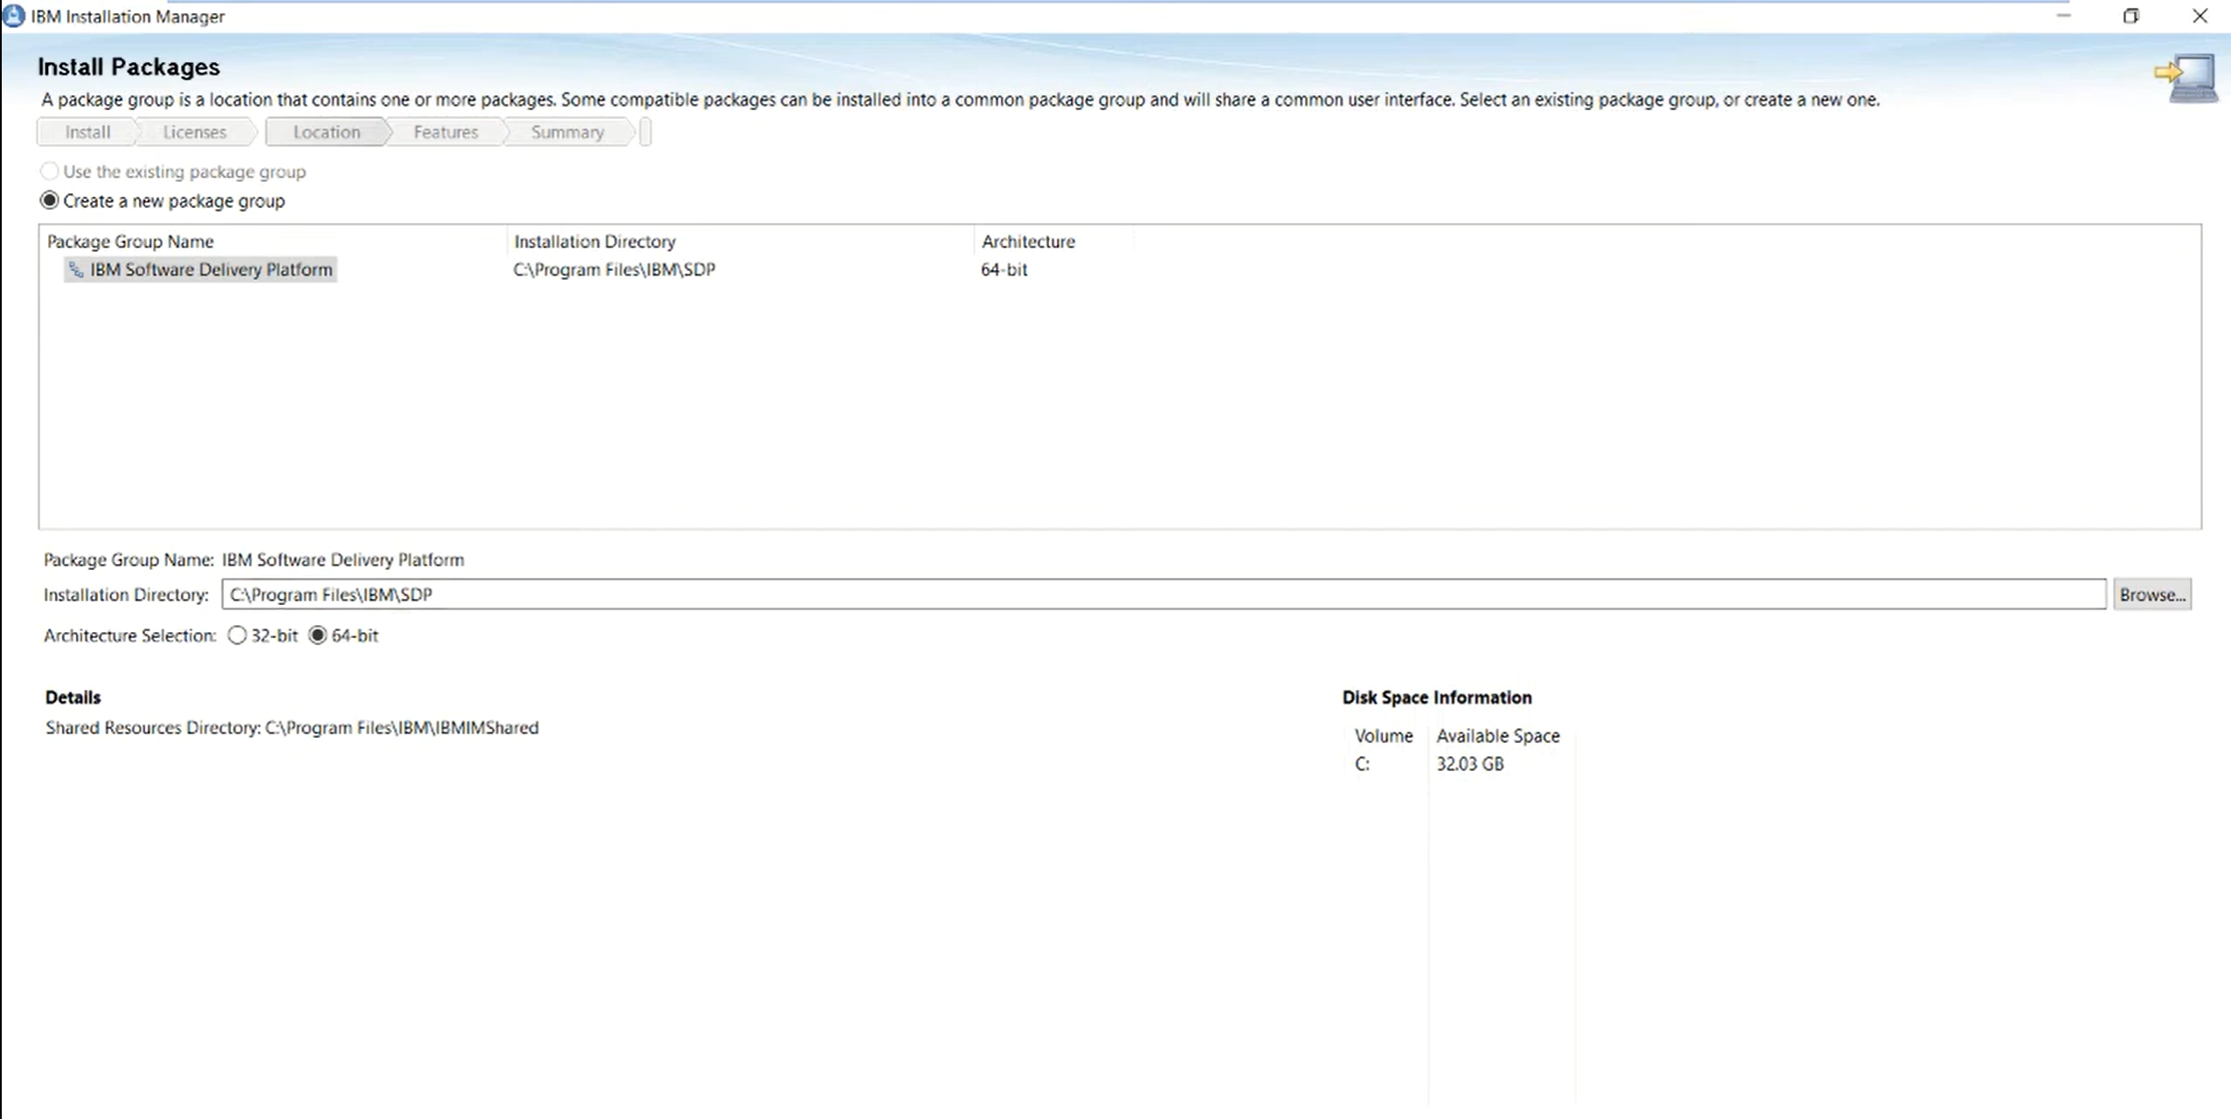

Slide 17
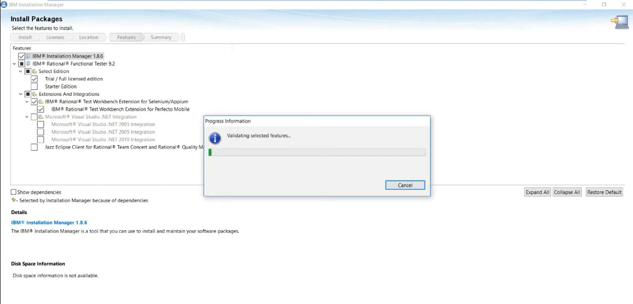

Slide 18
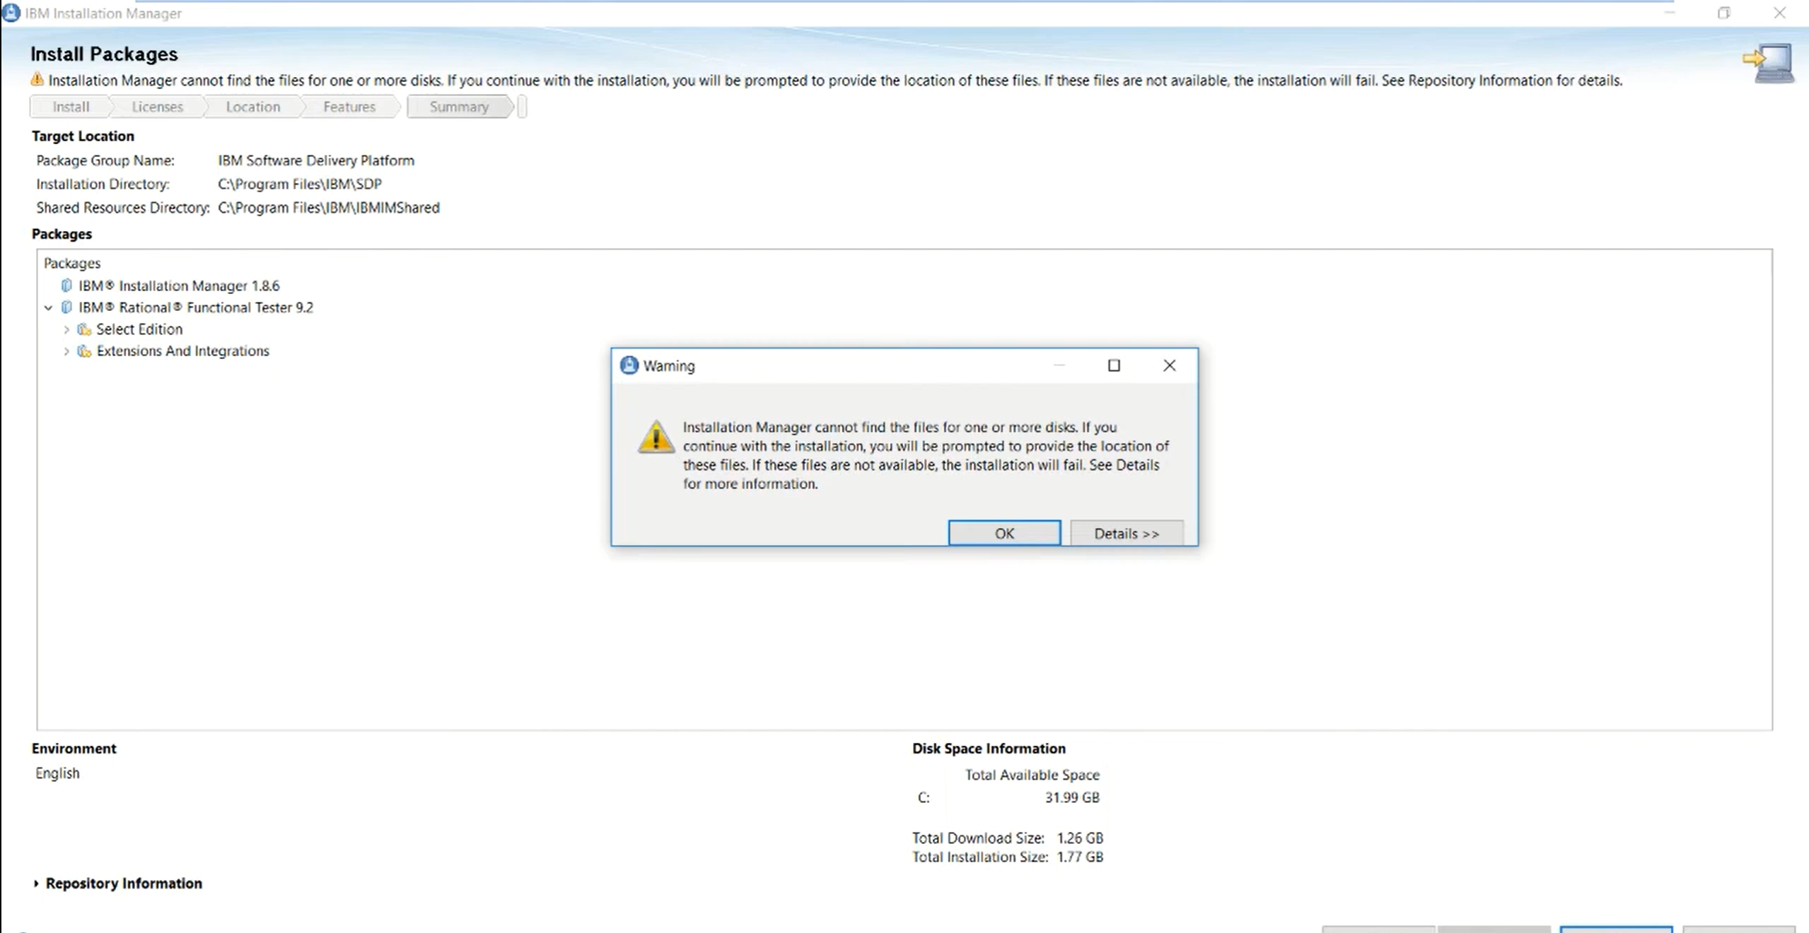

Slide 19
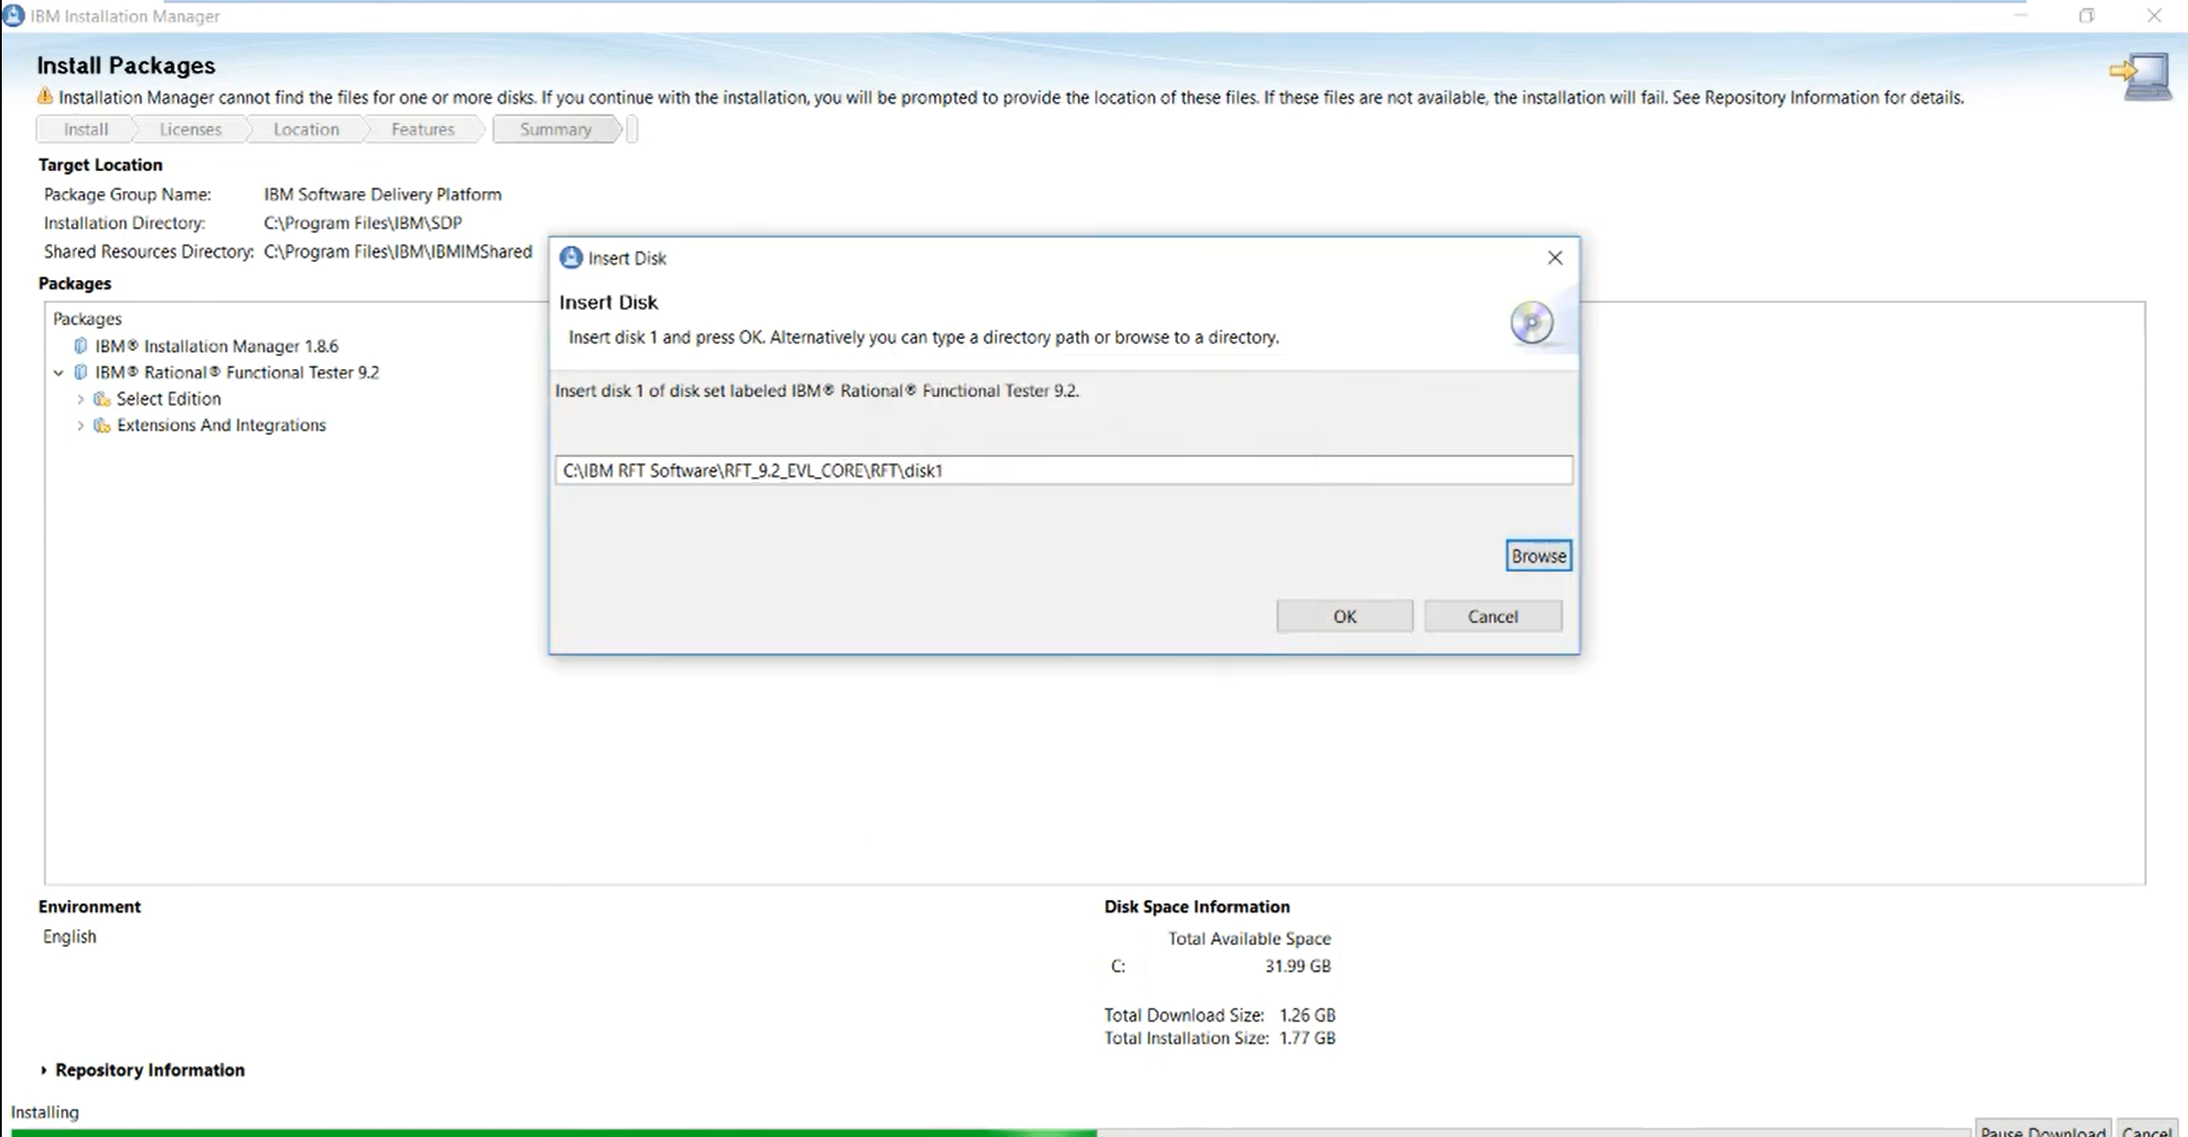

Slide 20
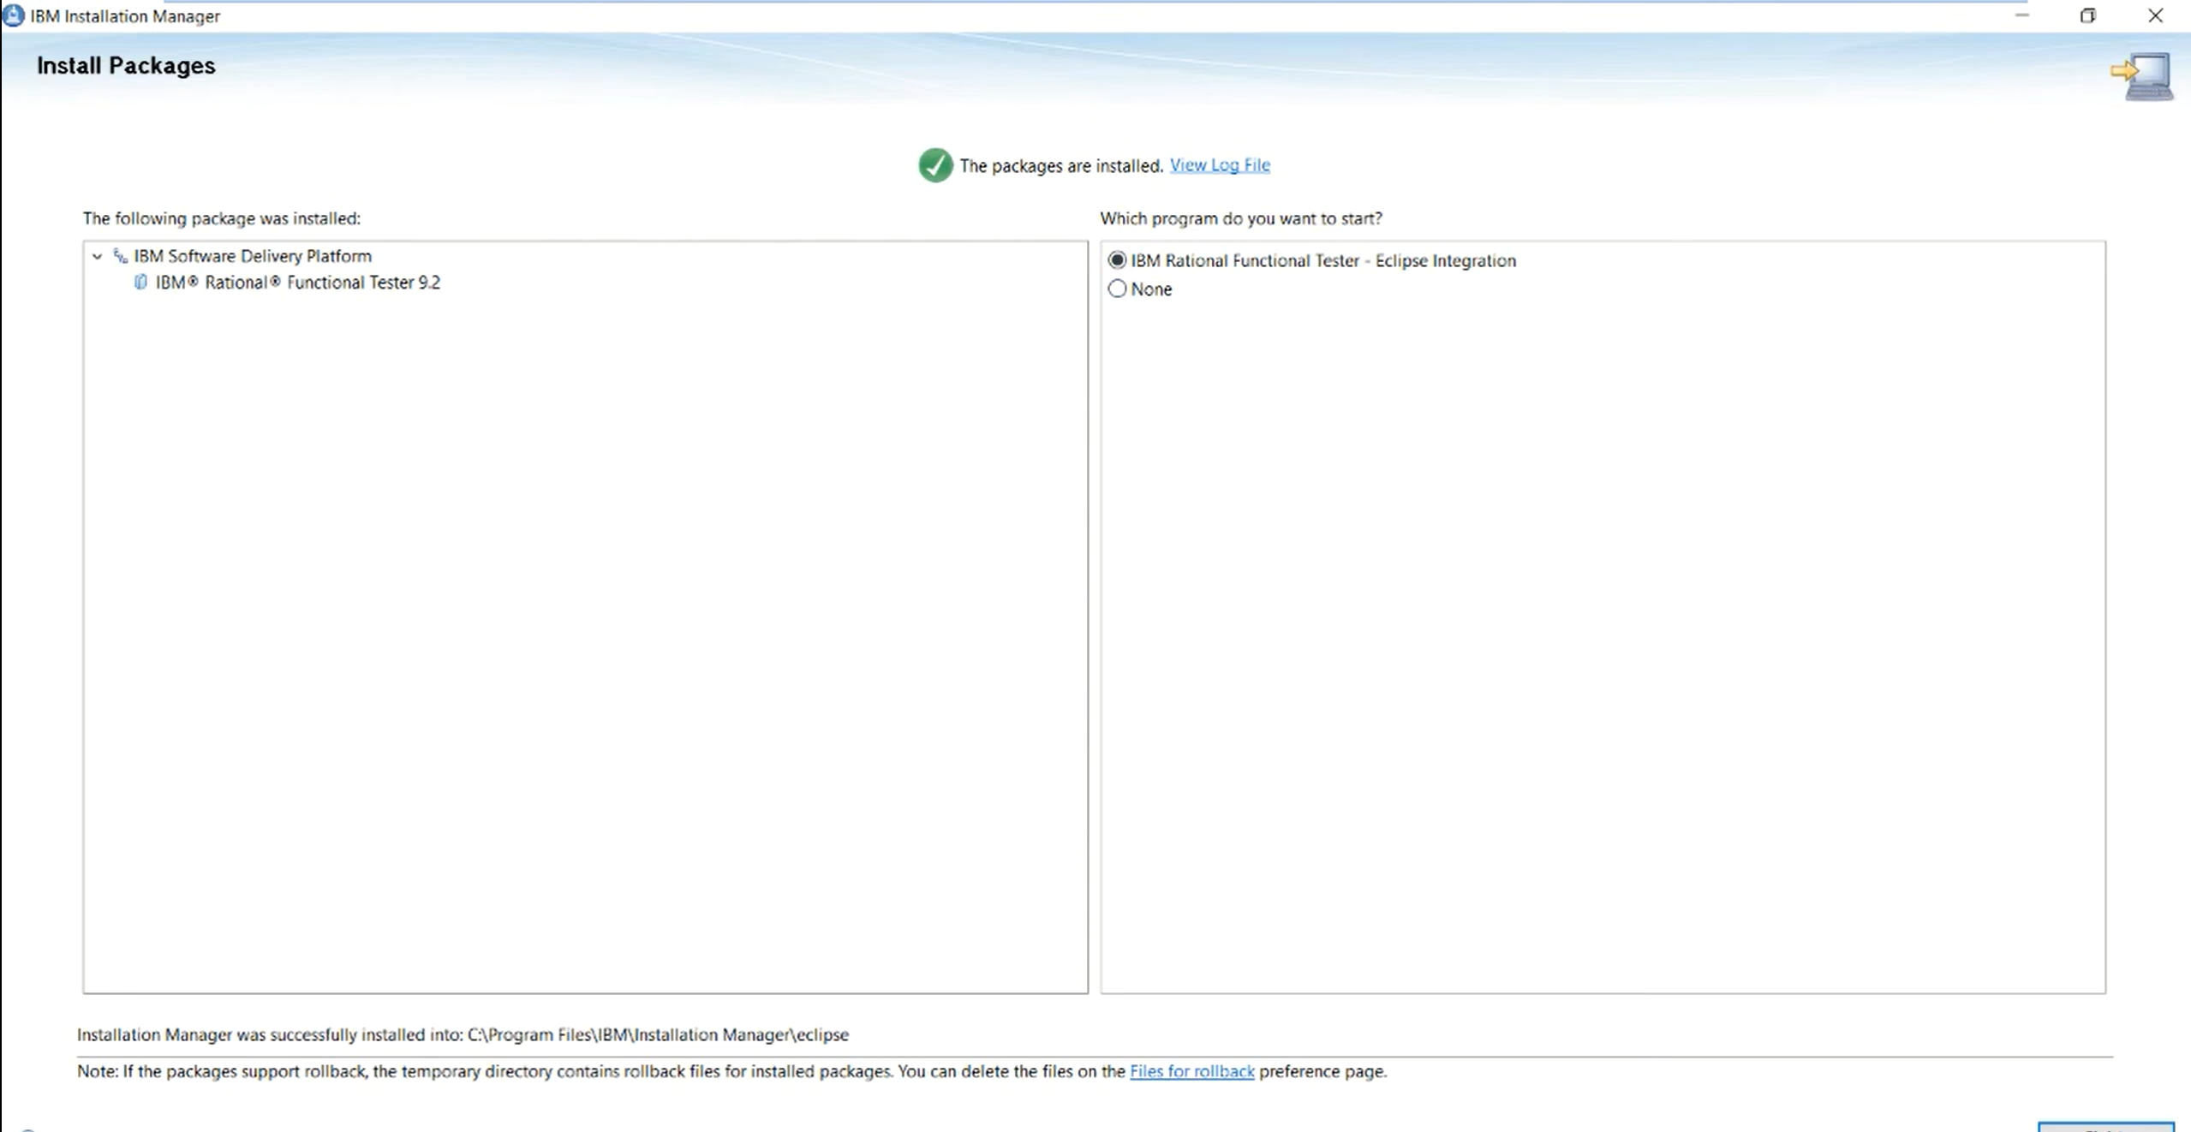

Slide 21
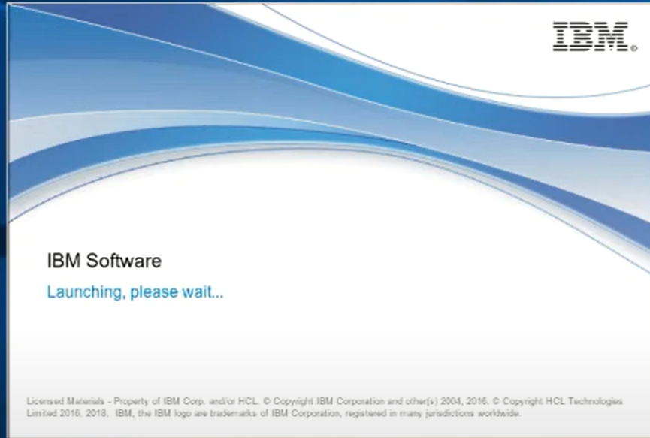

Slide 22
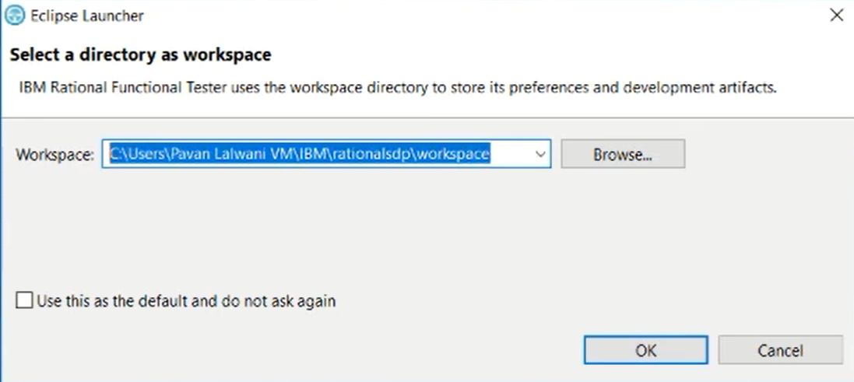

Slide 23
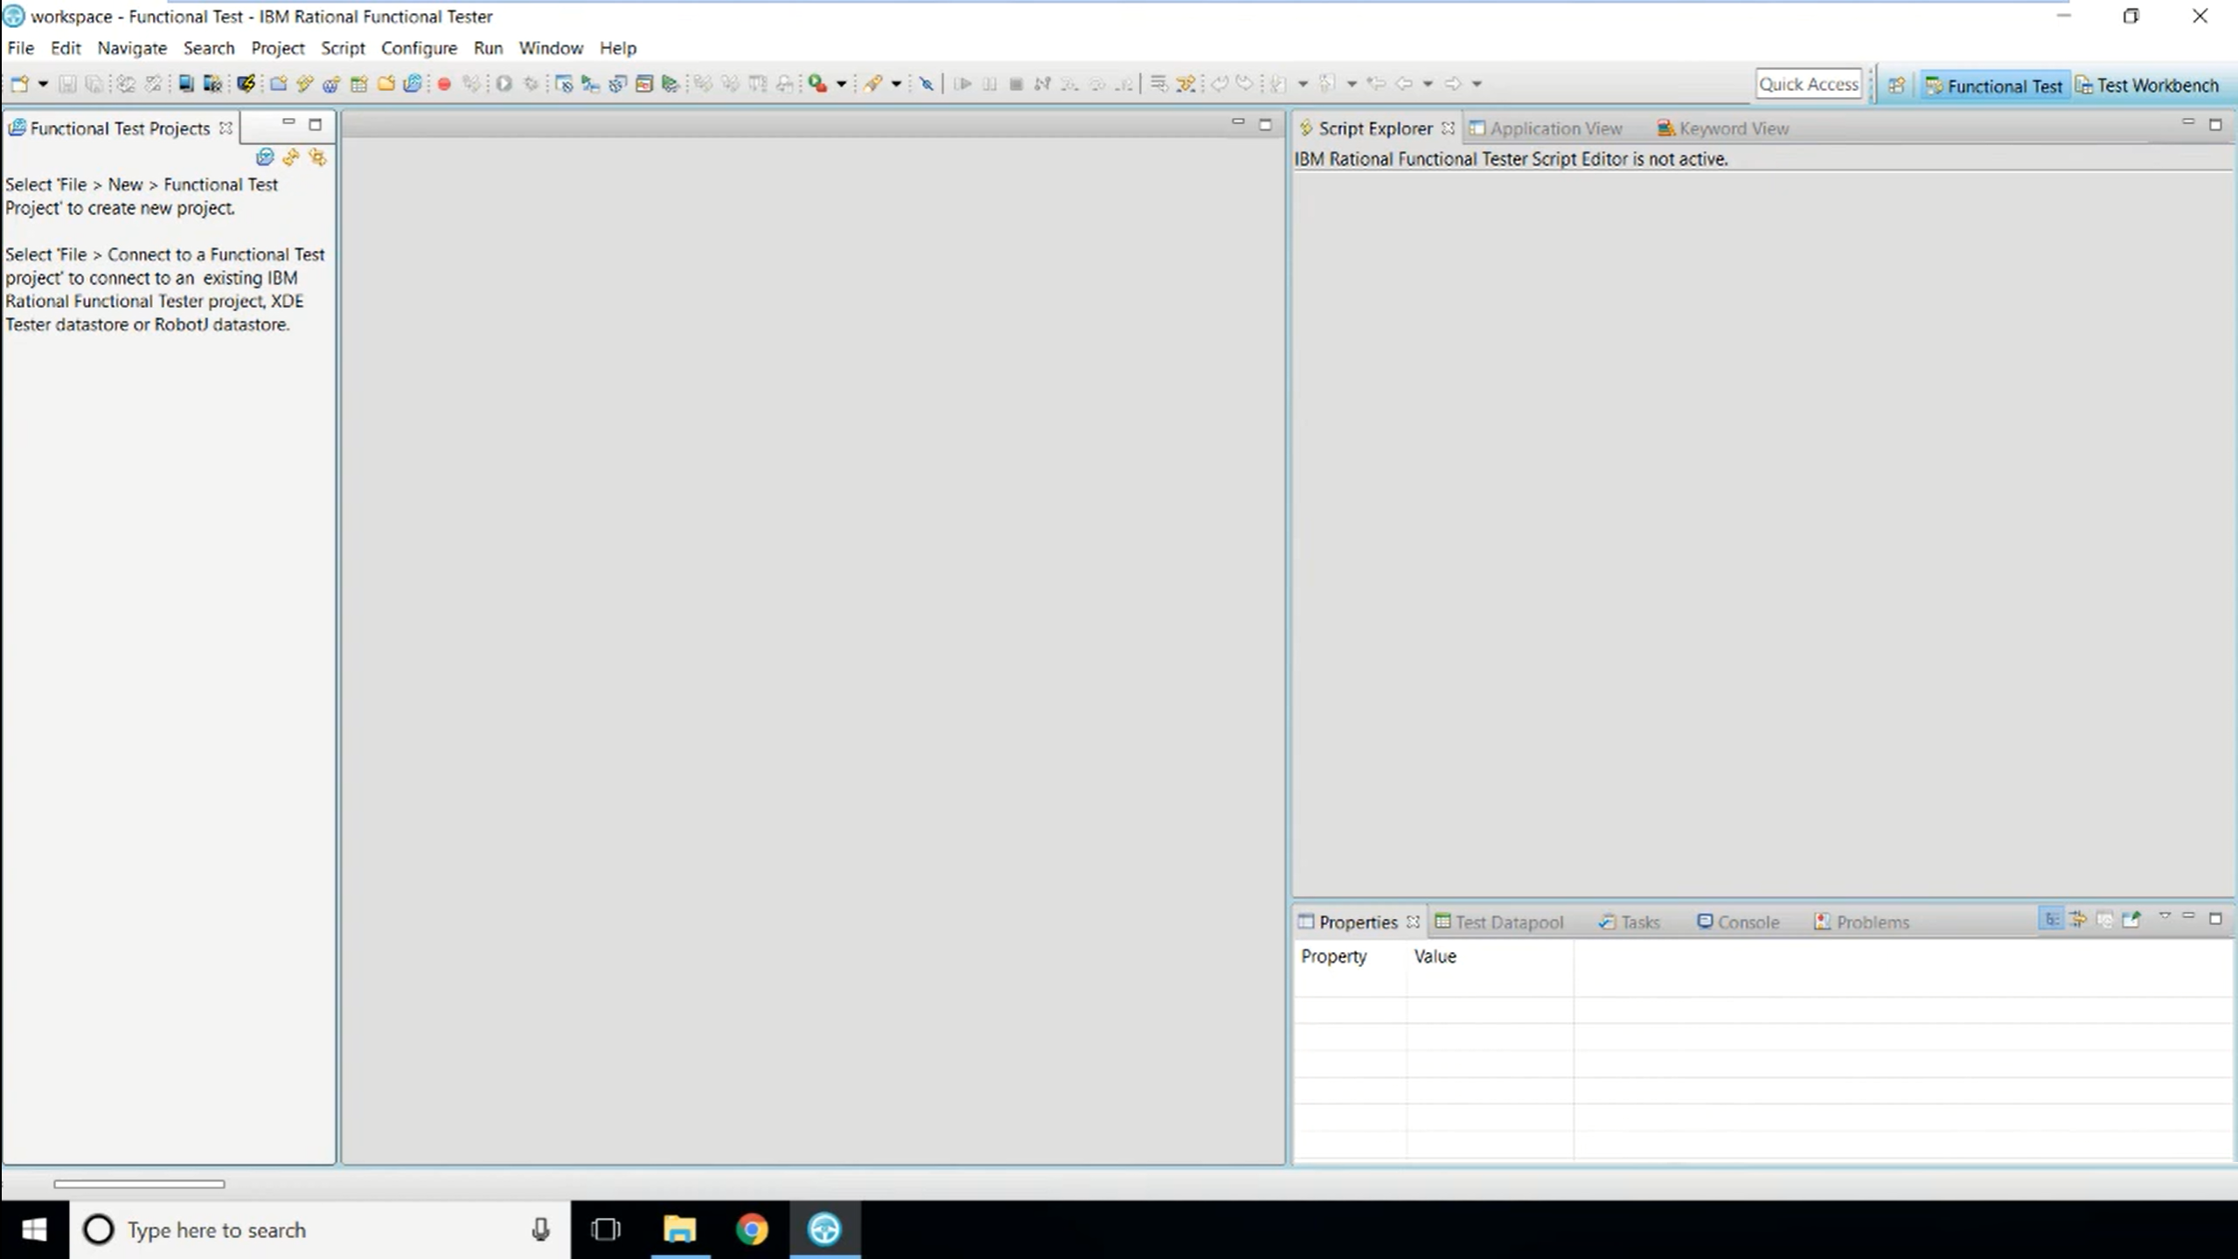

Slide 24
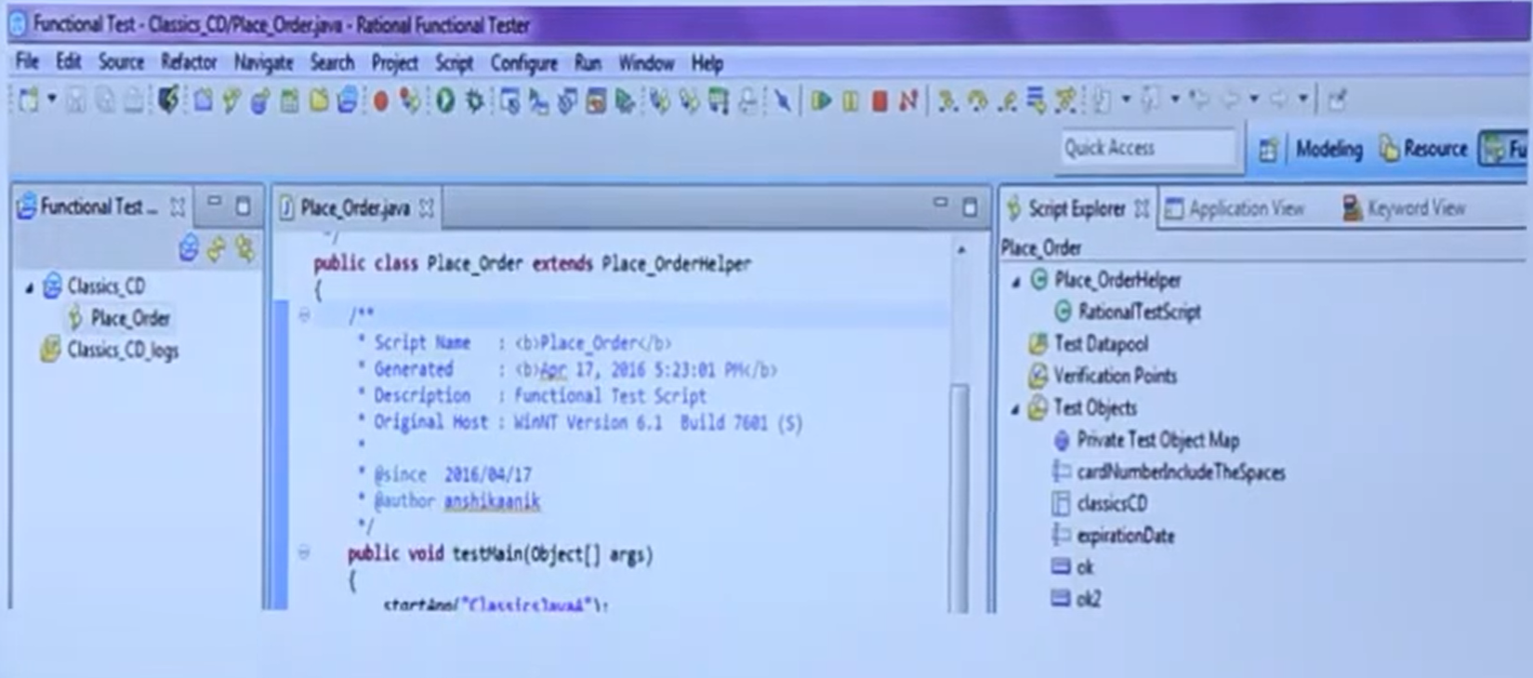

Slide 25
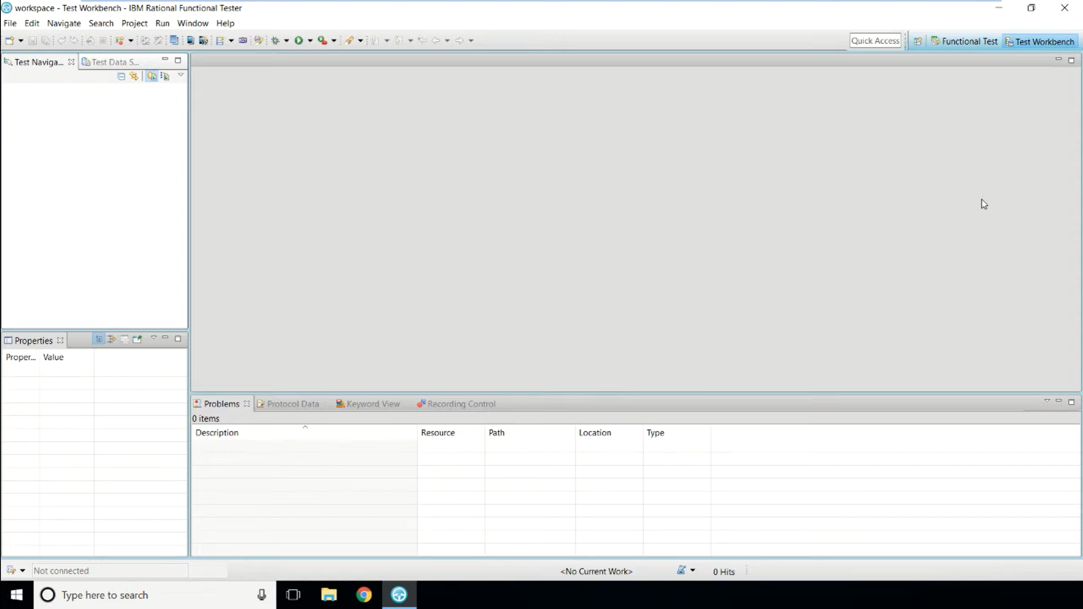

Slide 26
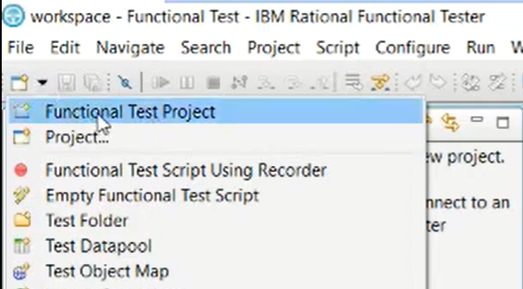
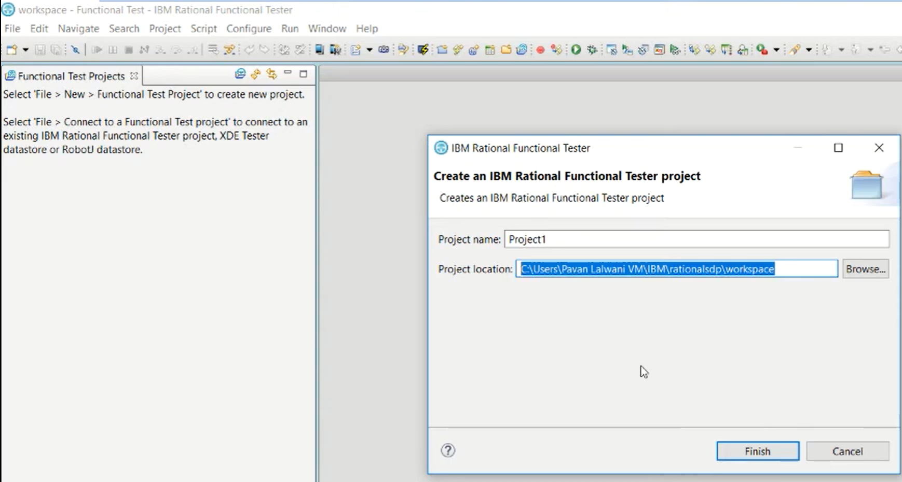

Slide 27
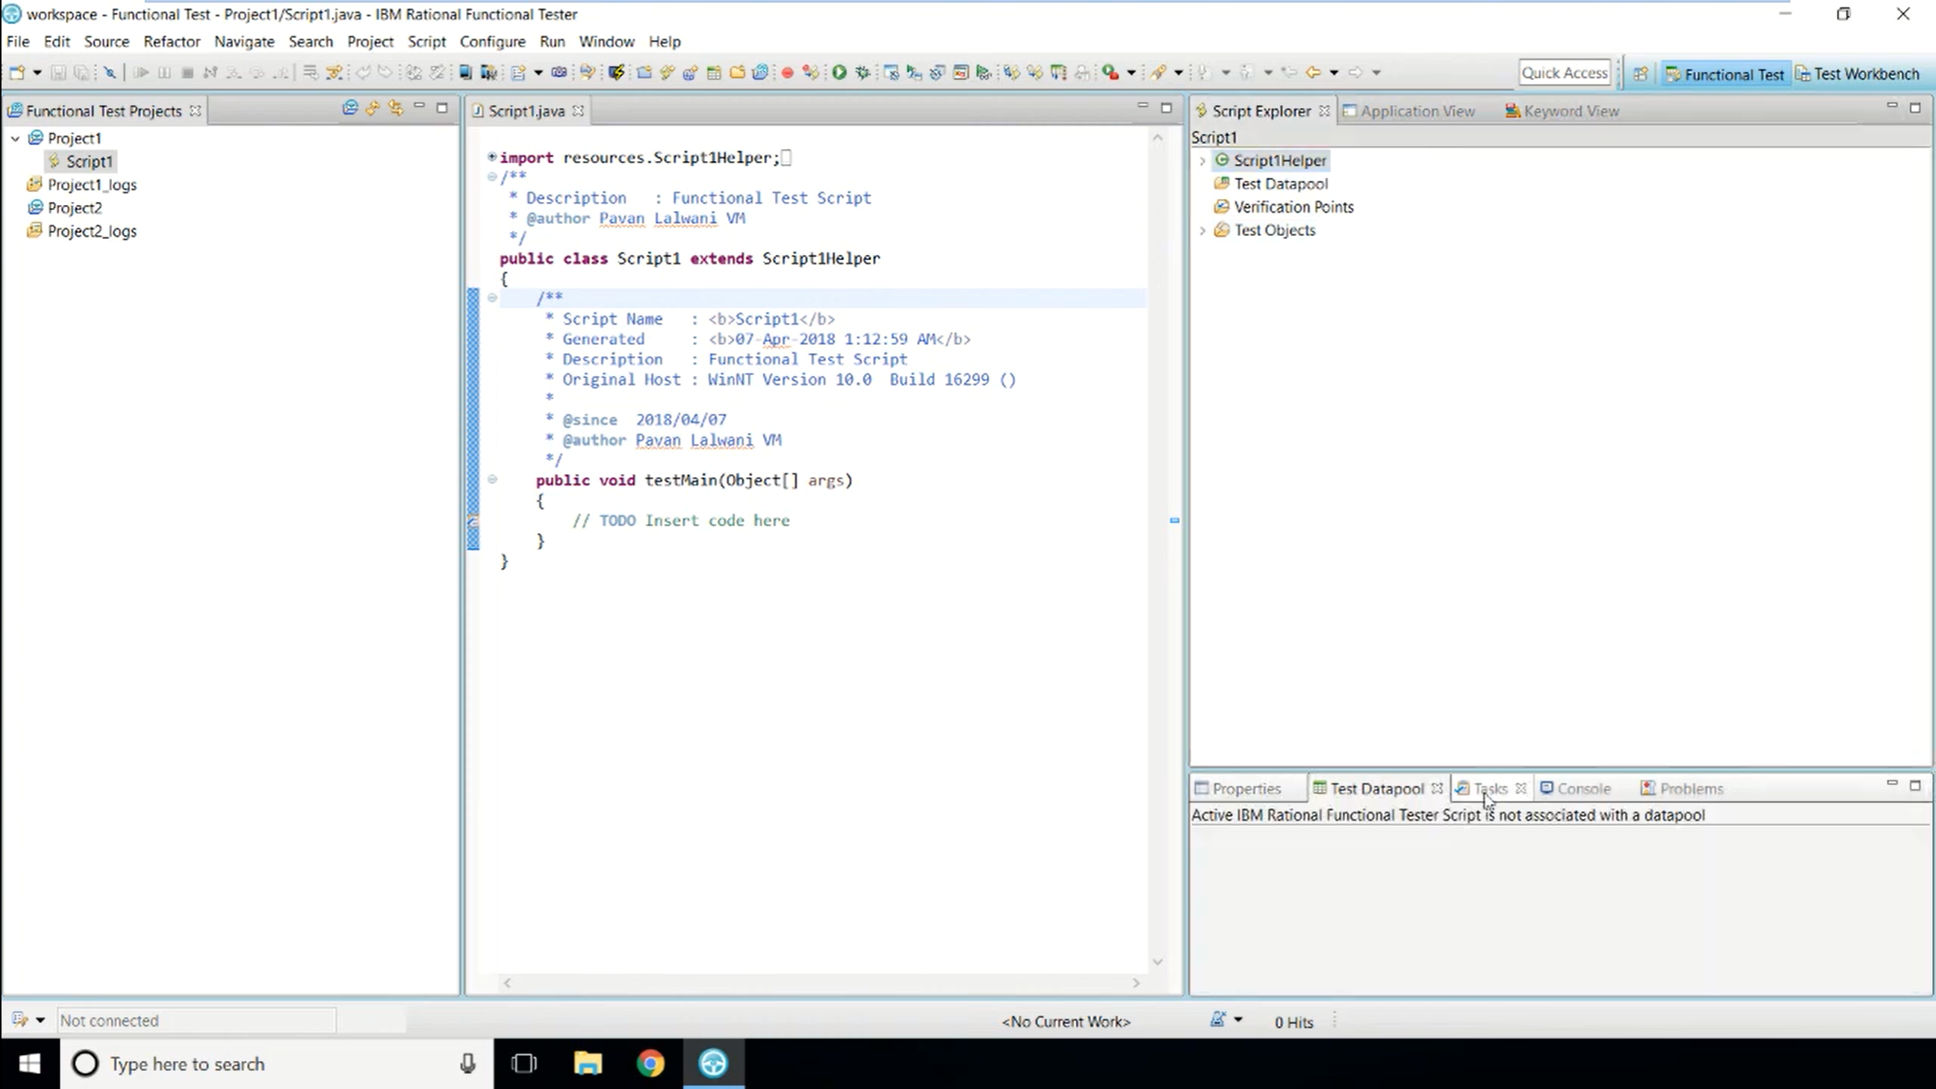

Slide 28
Sample App
ClassicsCD
ClassicsJavaA
ClassicsJavaB
Overview of the application
Start the application
Select the composition
Log into the account
Data Entry fields
Place the order

Slide 29
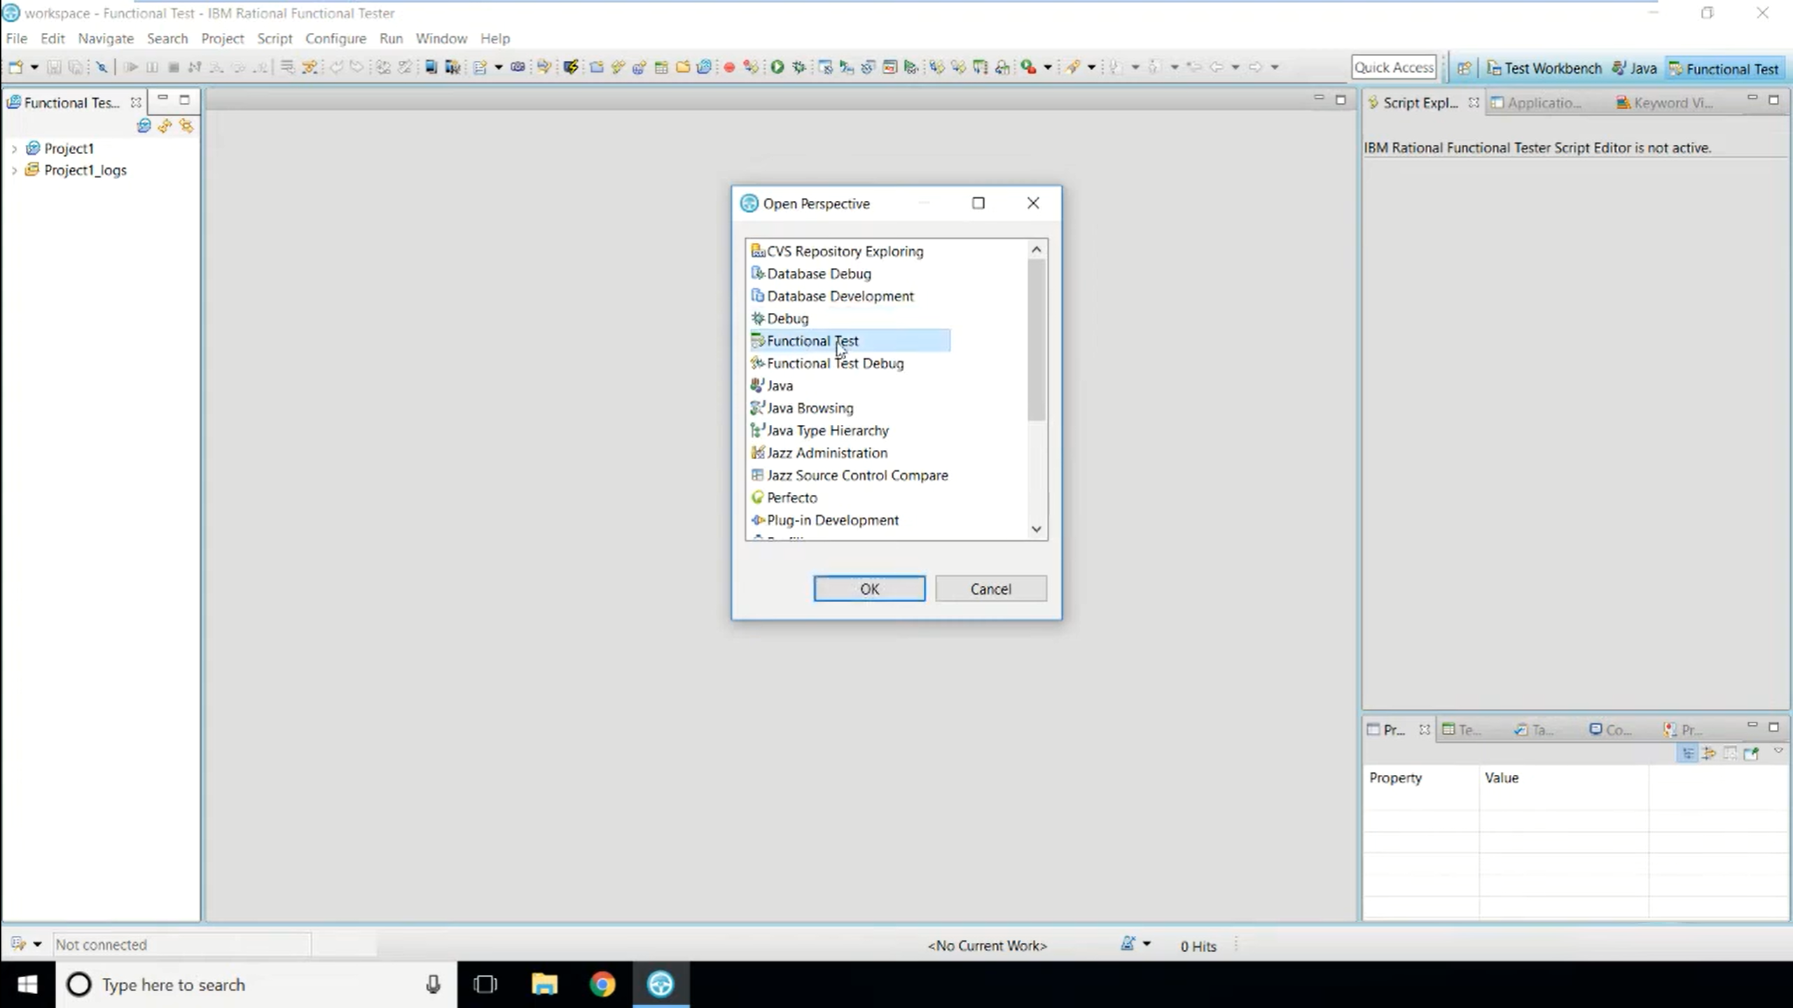

Slide 30
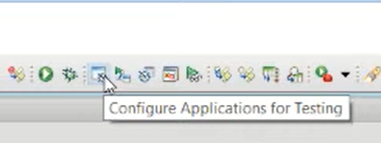

Slide 31
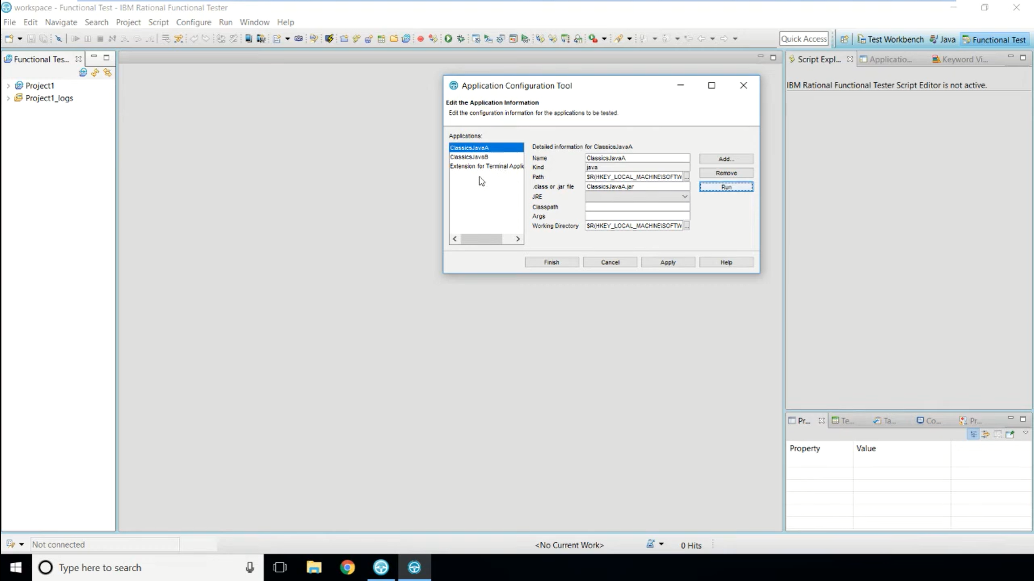

Slide 32
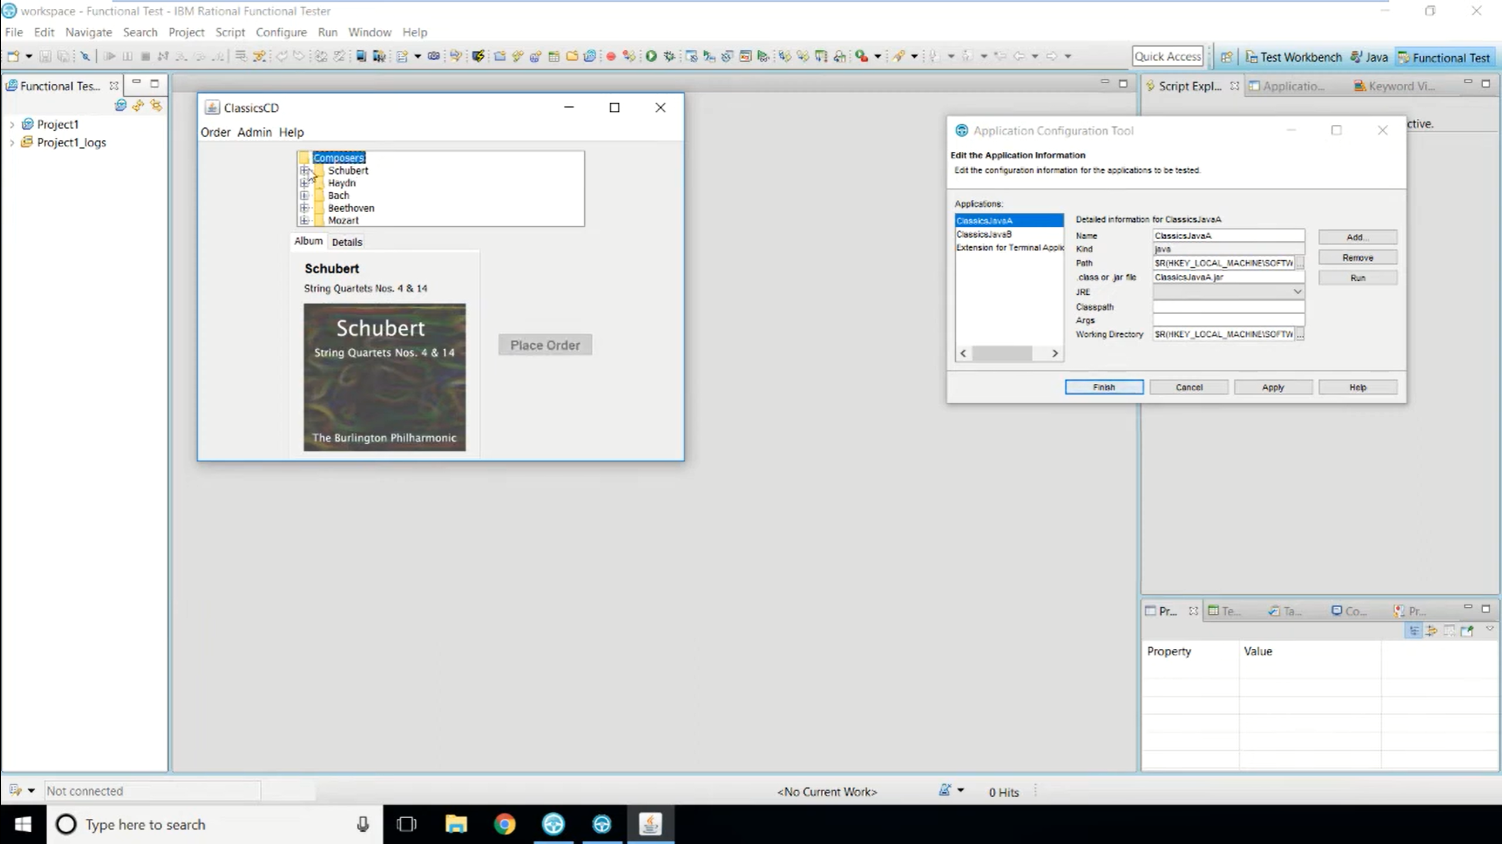

Slide 33
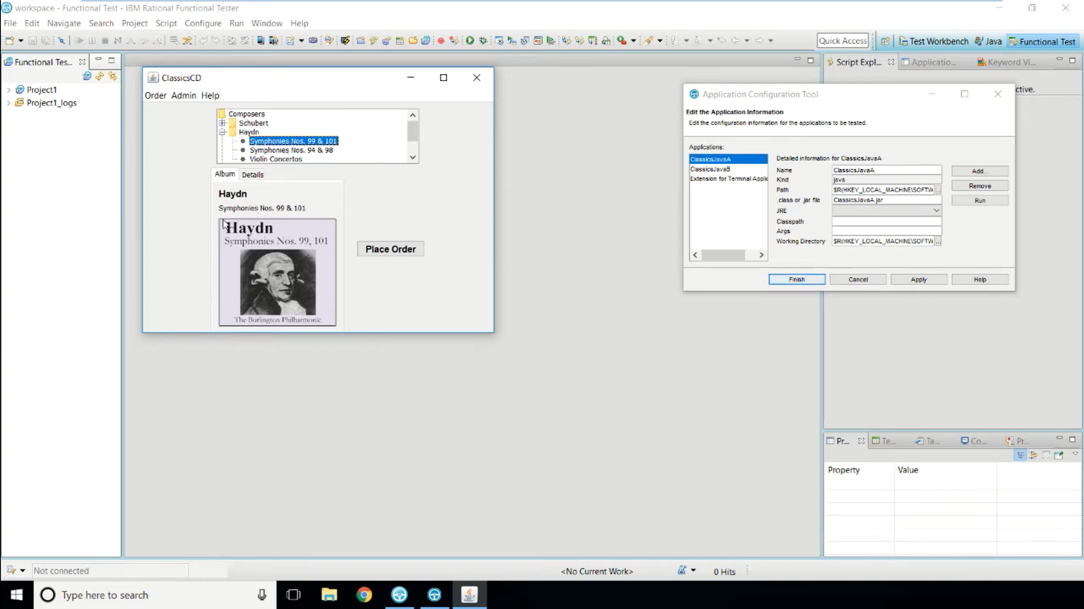

Slide 34
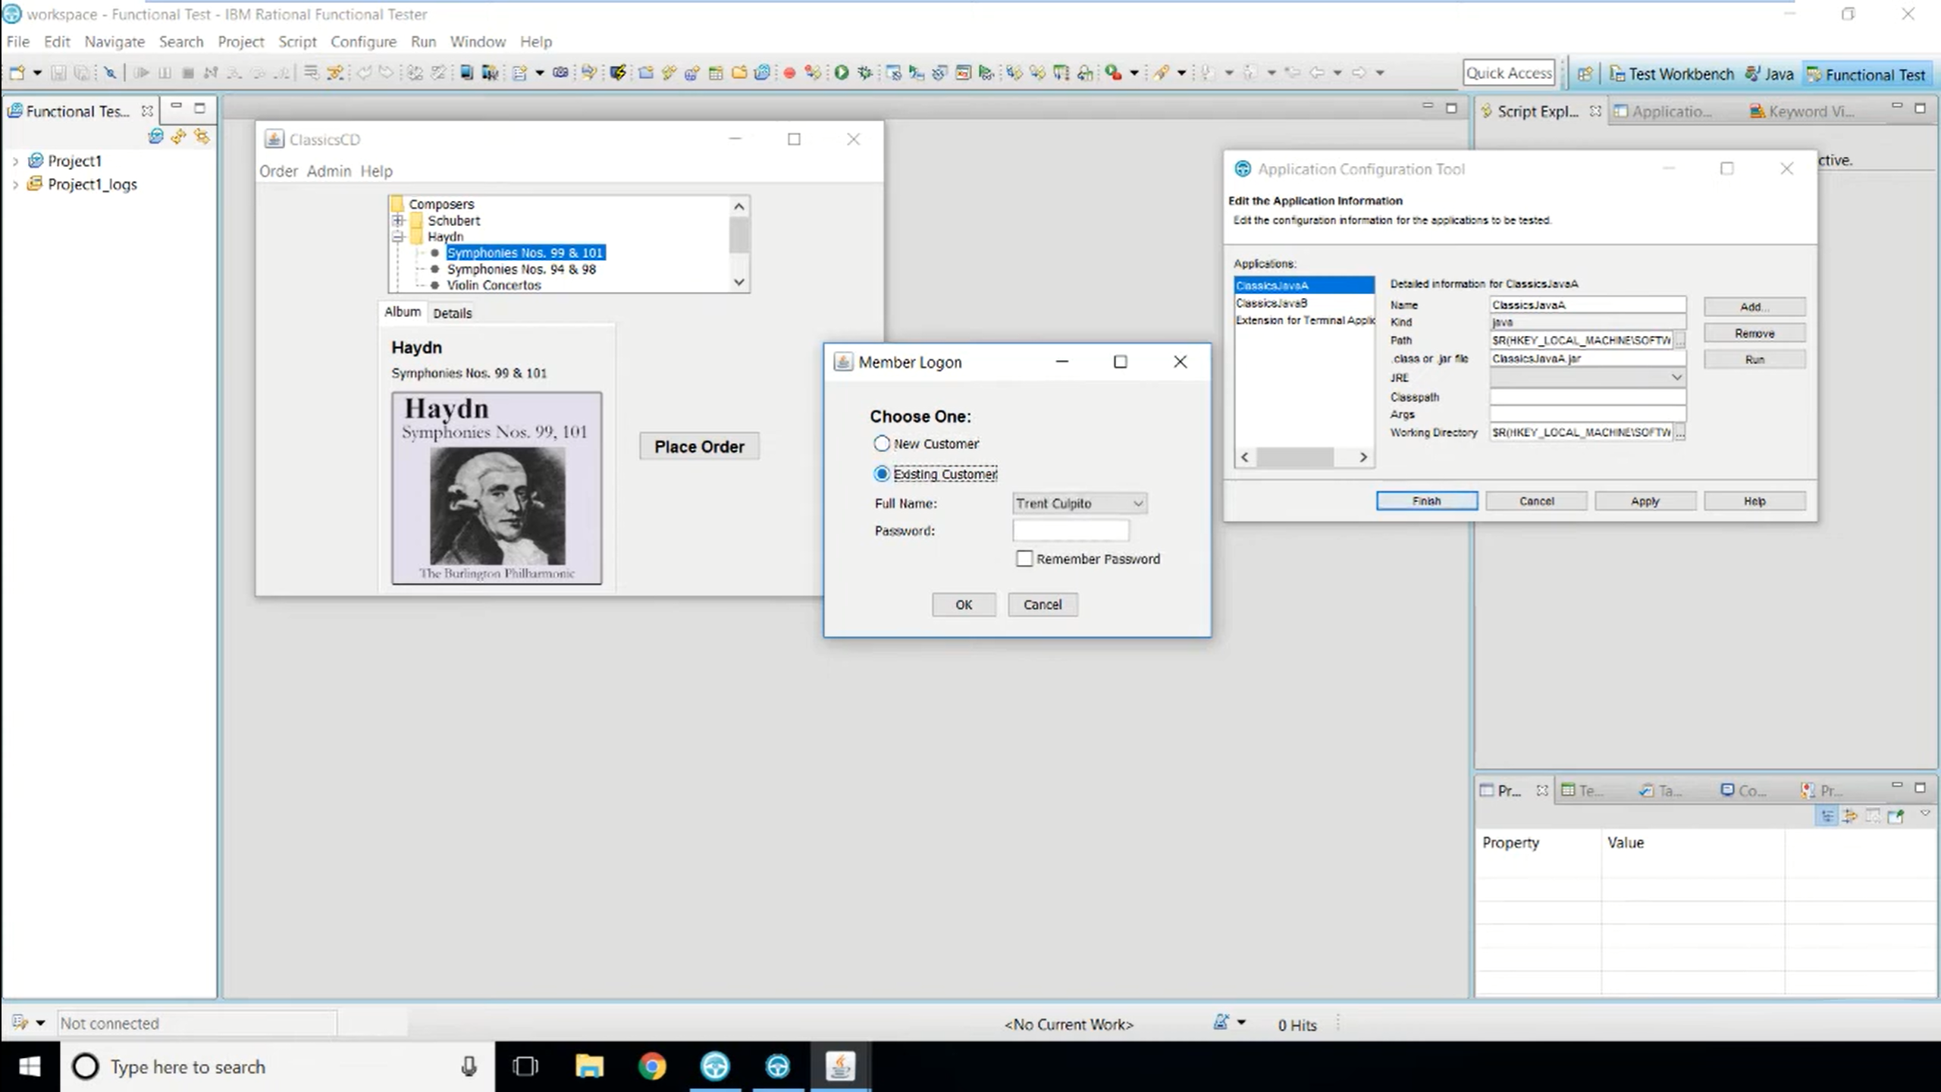

Slide 35
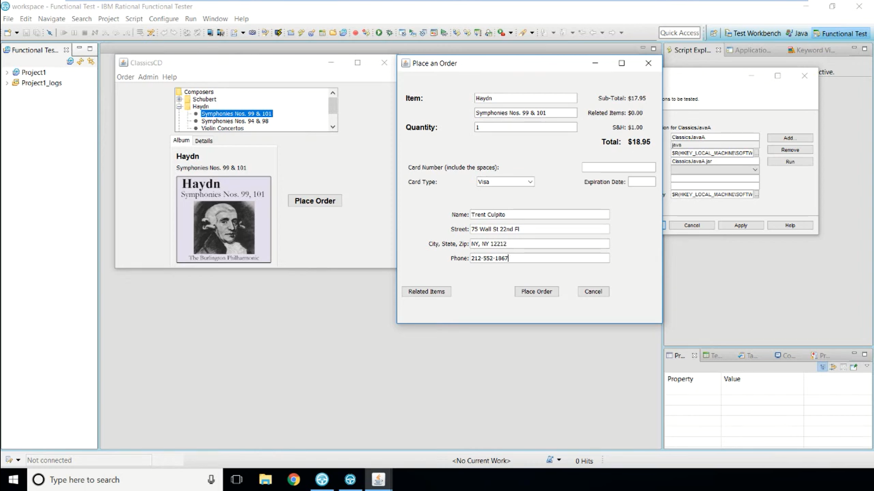

Slide 36
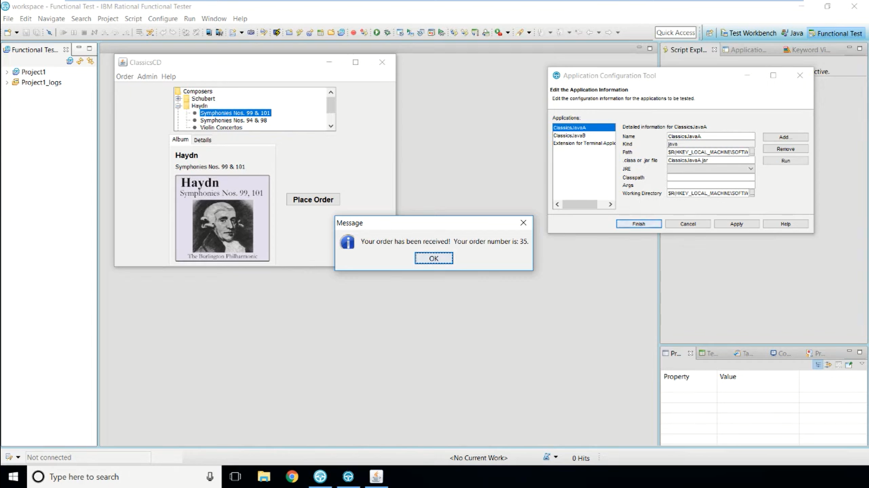

Slide 37
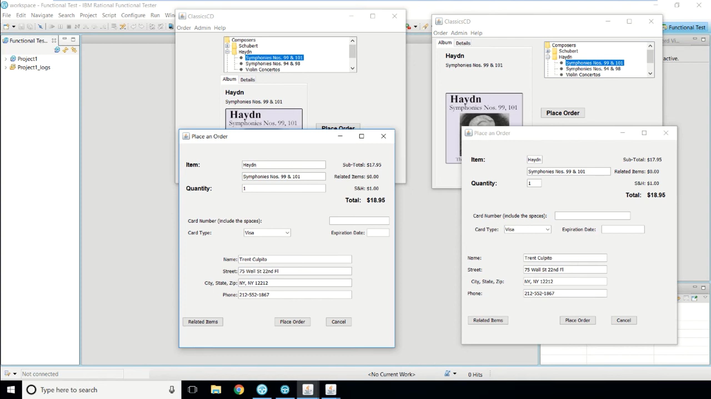

Slide 38
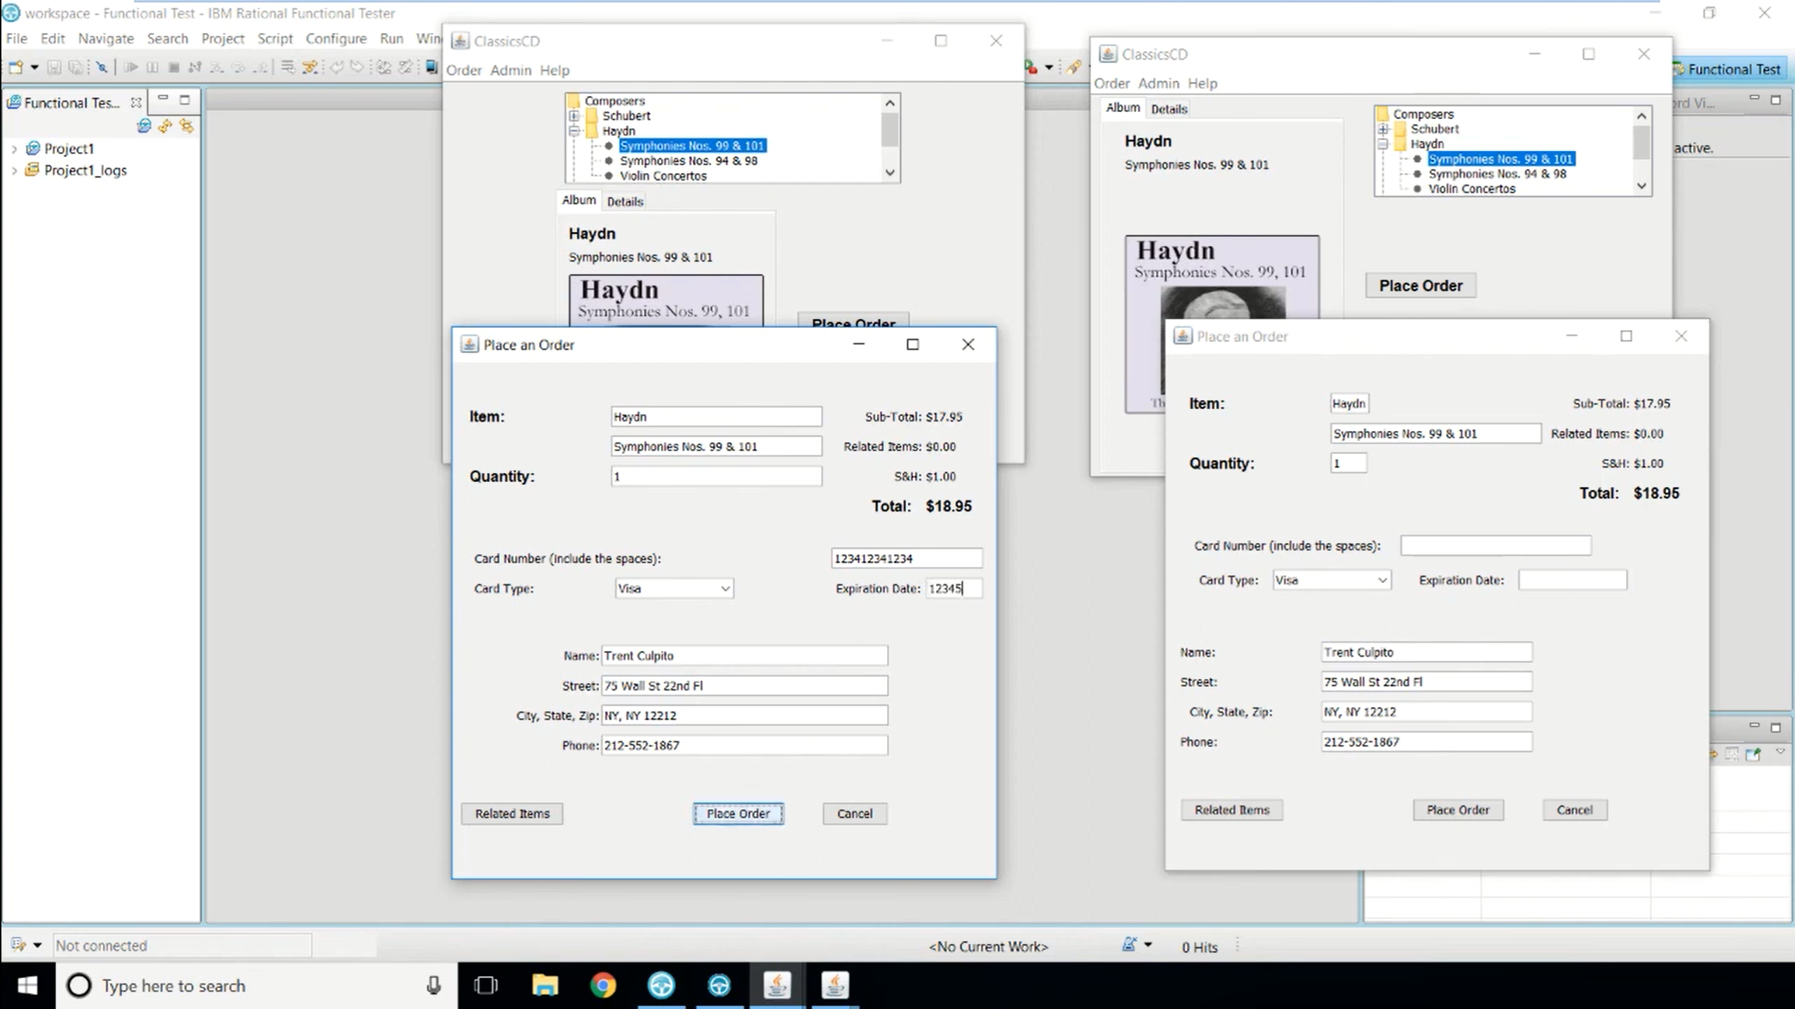
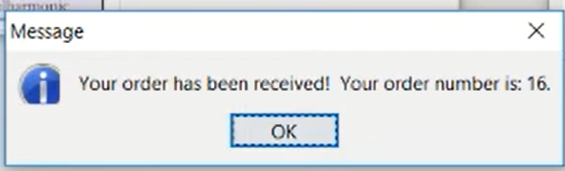
Incorrect cc details

Slide 39
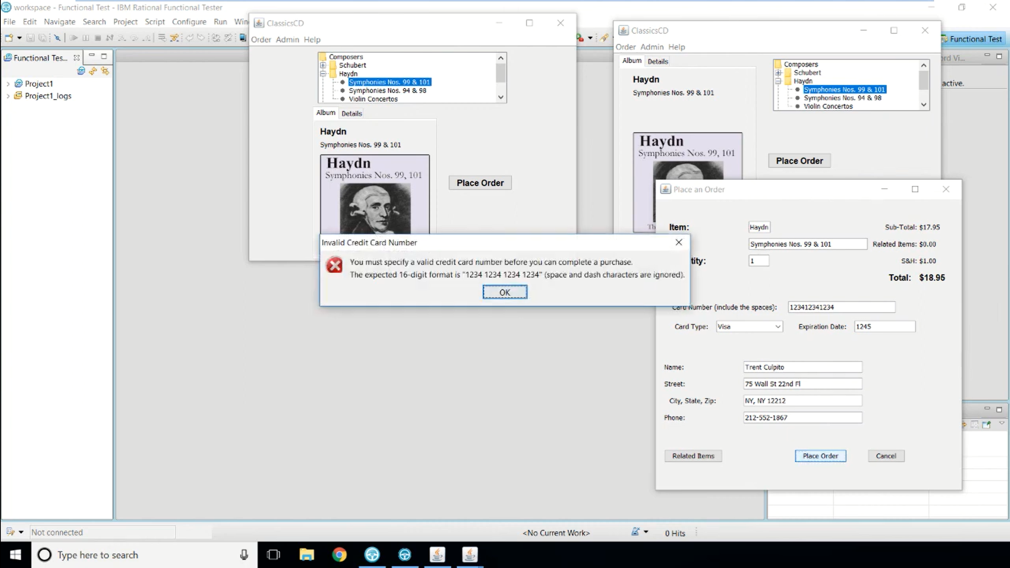

Slide 40
Scripts Recording & Play back
Sect up test environment
set recording options
Start Recording
Perform user actions
Insert verification points
End recording
Set playback options
Play back script
View and analyze results

Slide 41
Environment Setup
Configure Applications
Enable Environment

Slide 42
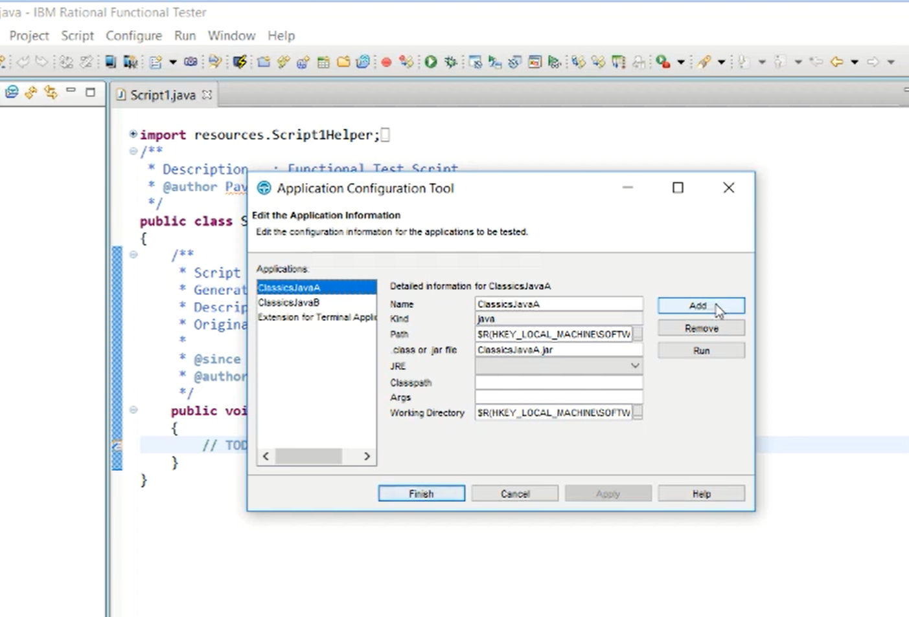

Slide 43
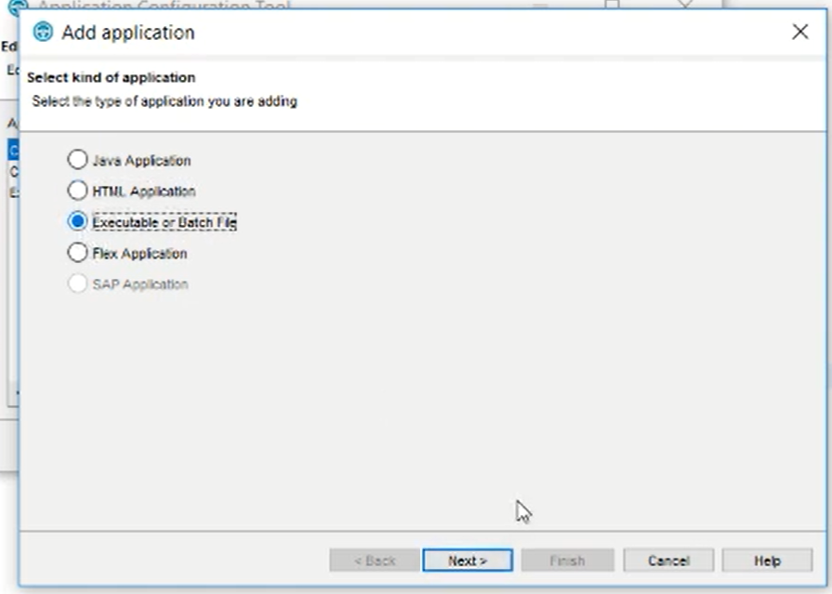

Slide 44
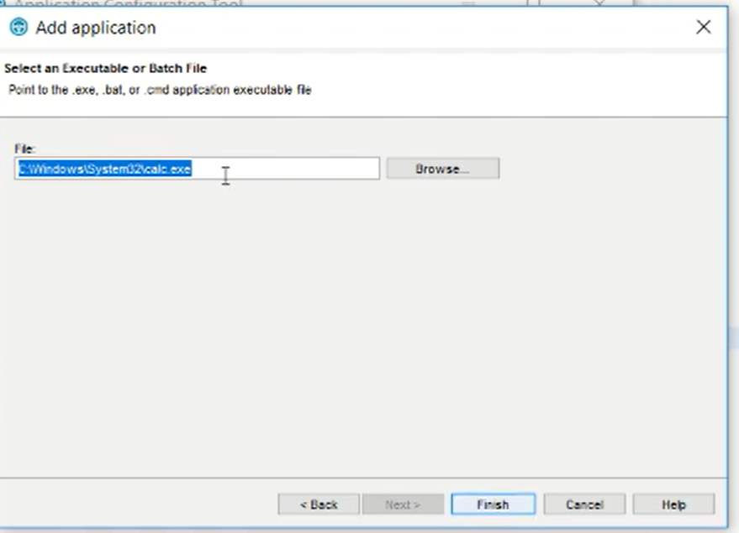

Slide 45
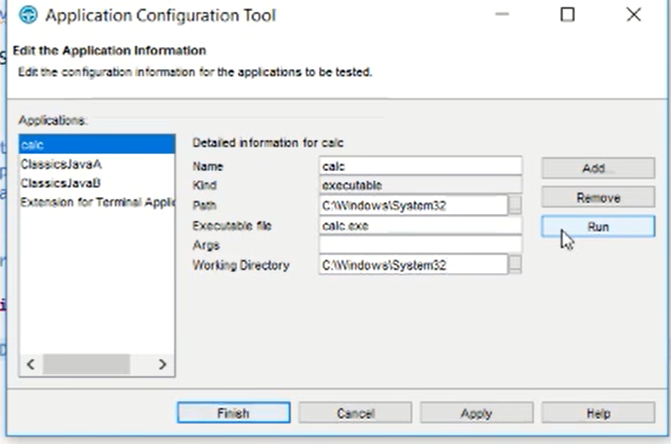

Slide 46
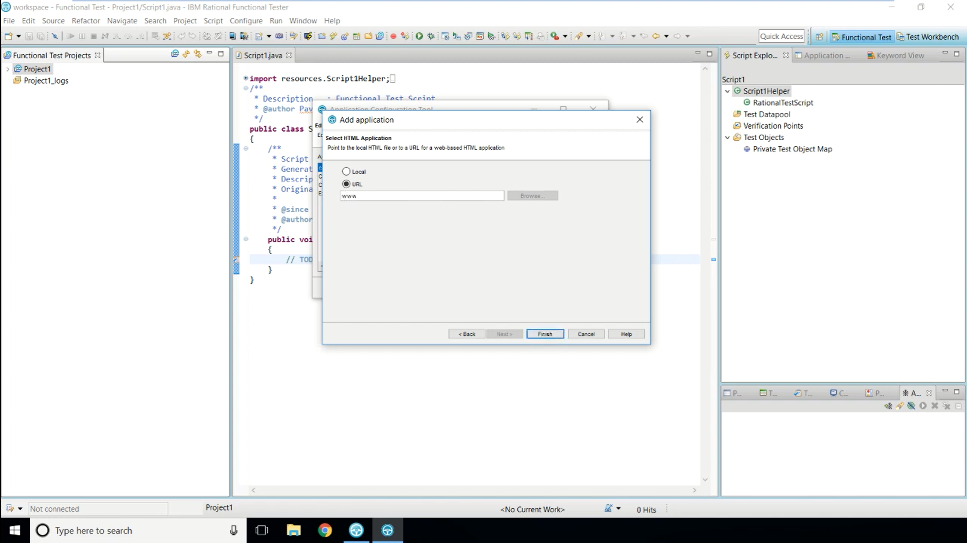

Slide 47
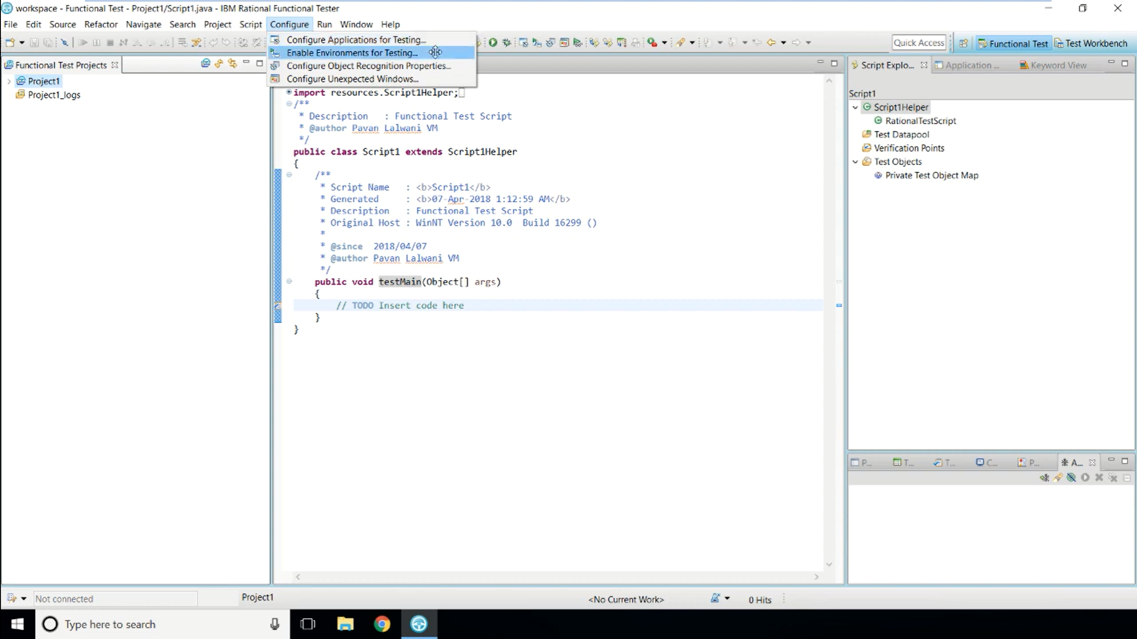

Slide 48
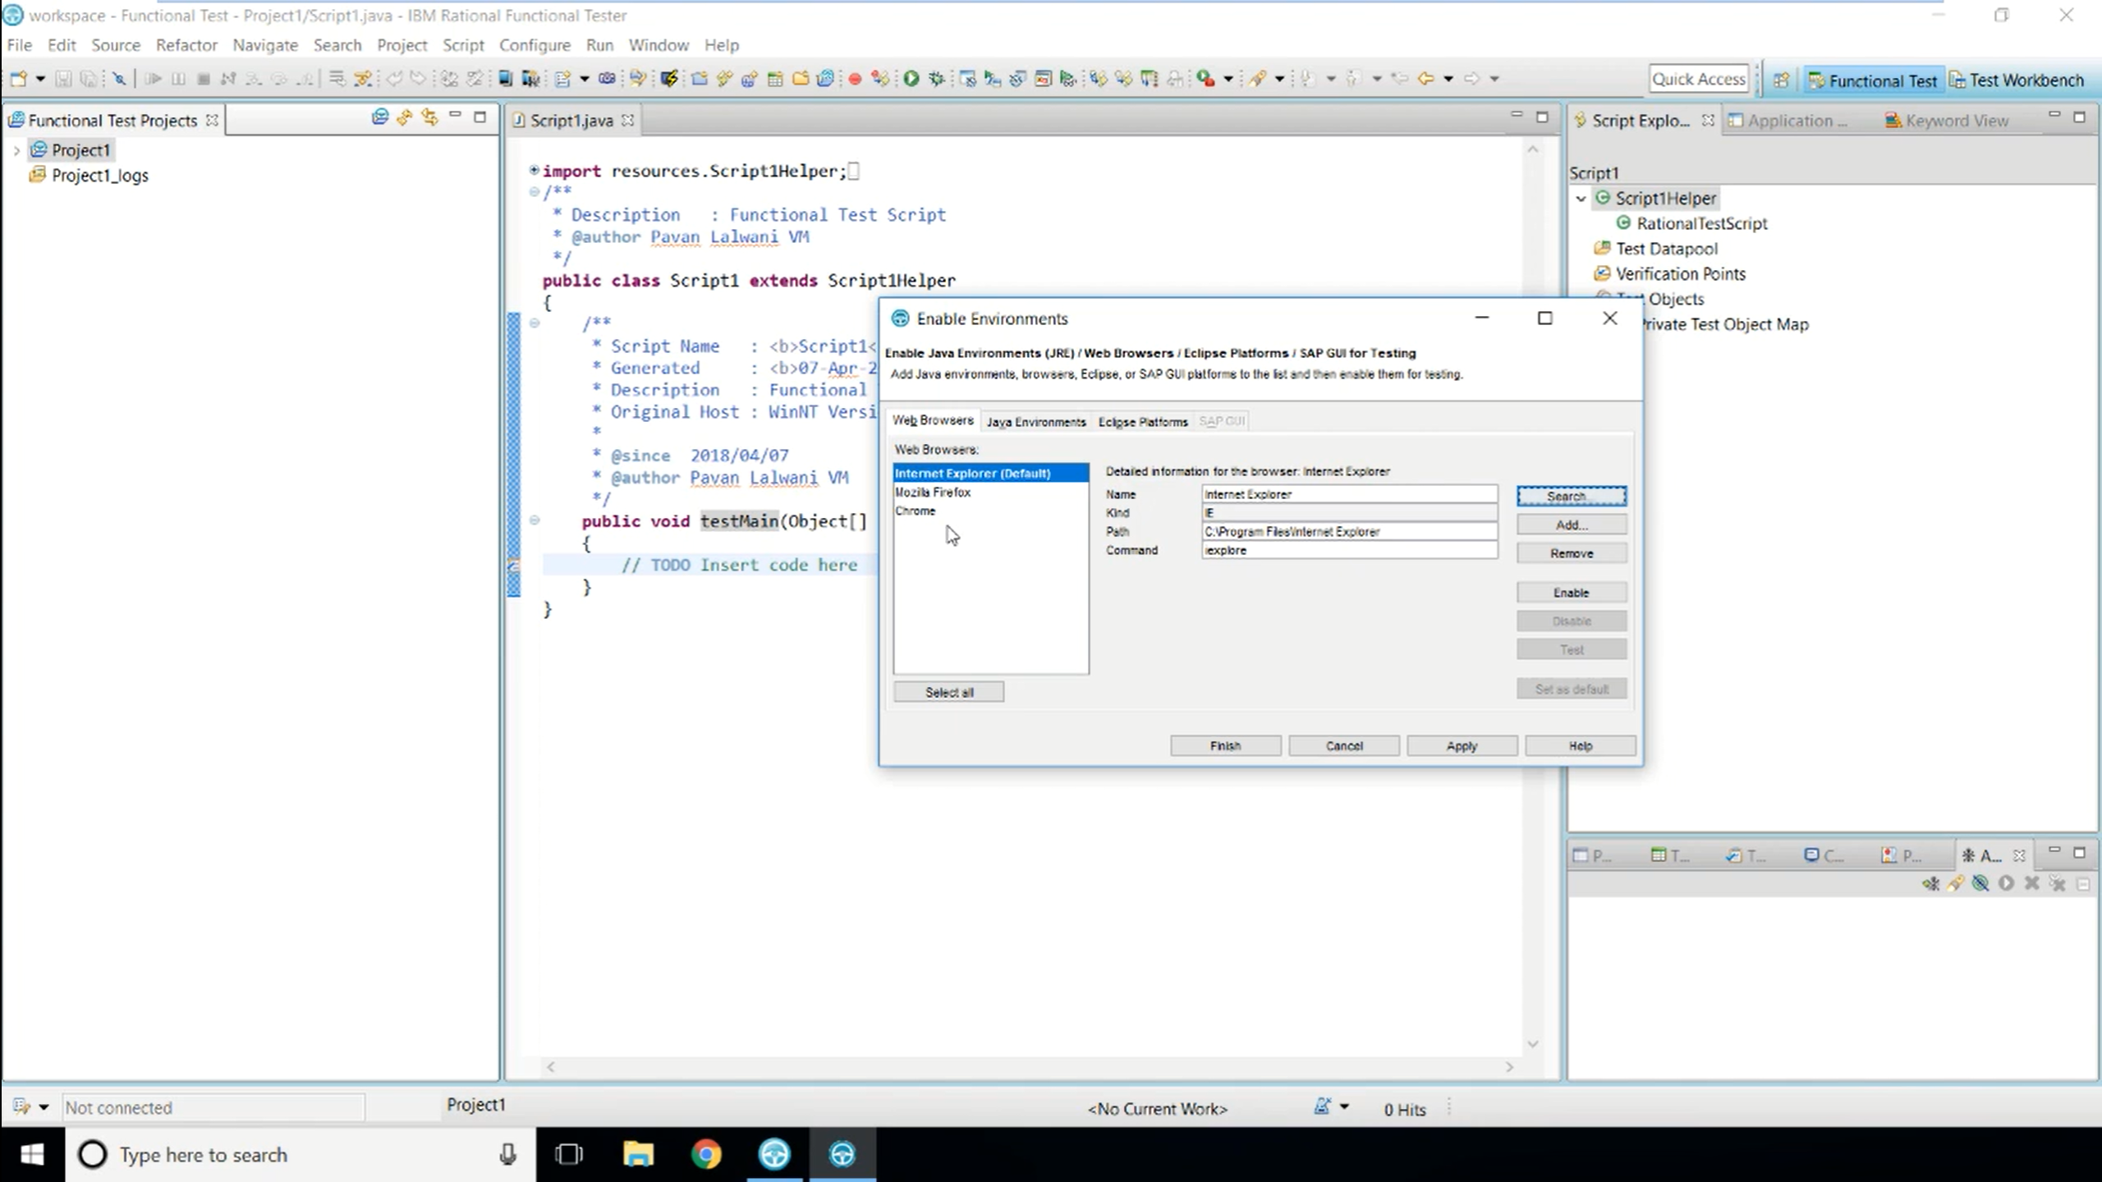

Slide 49
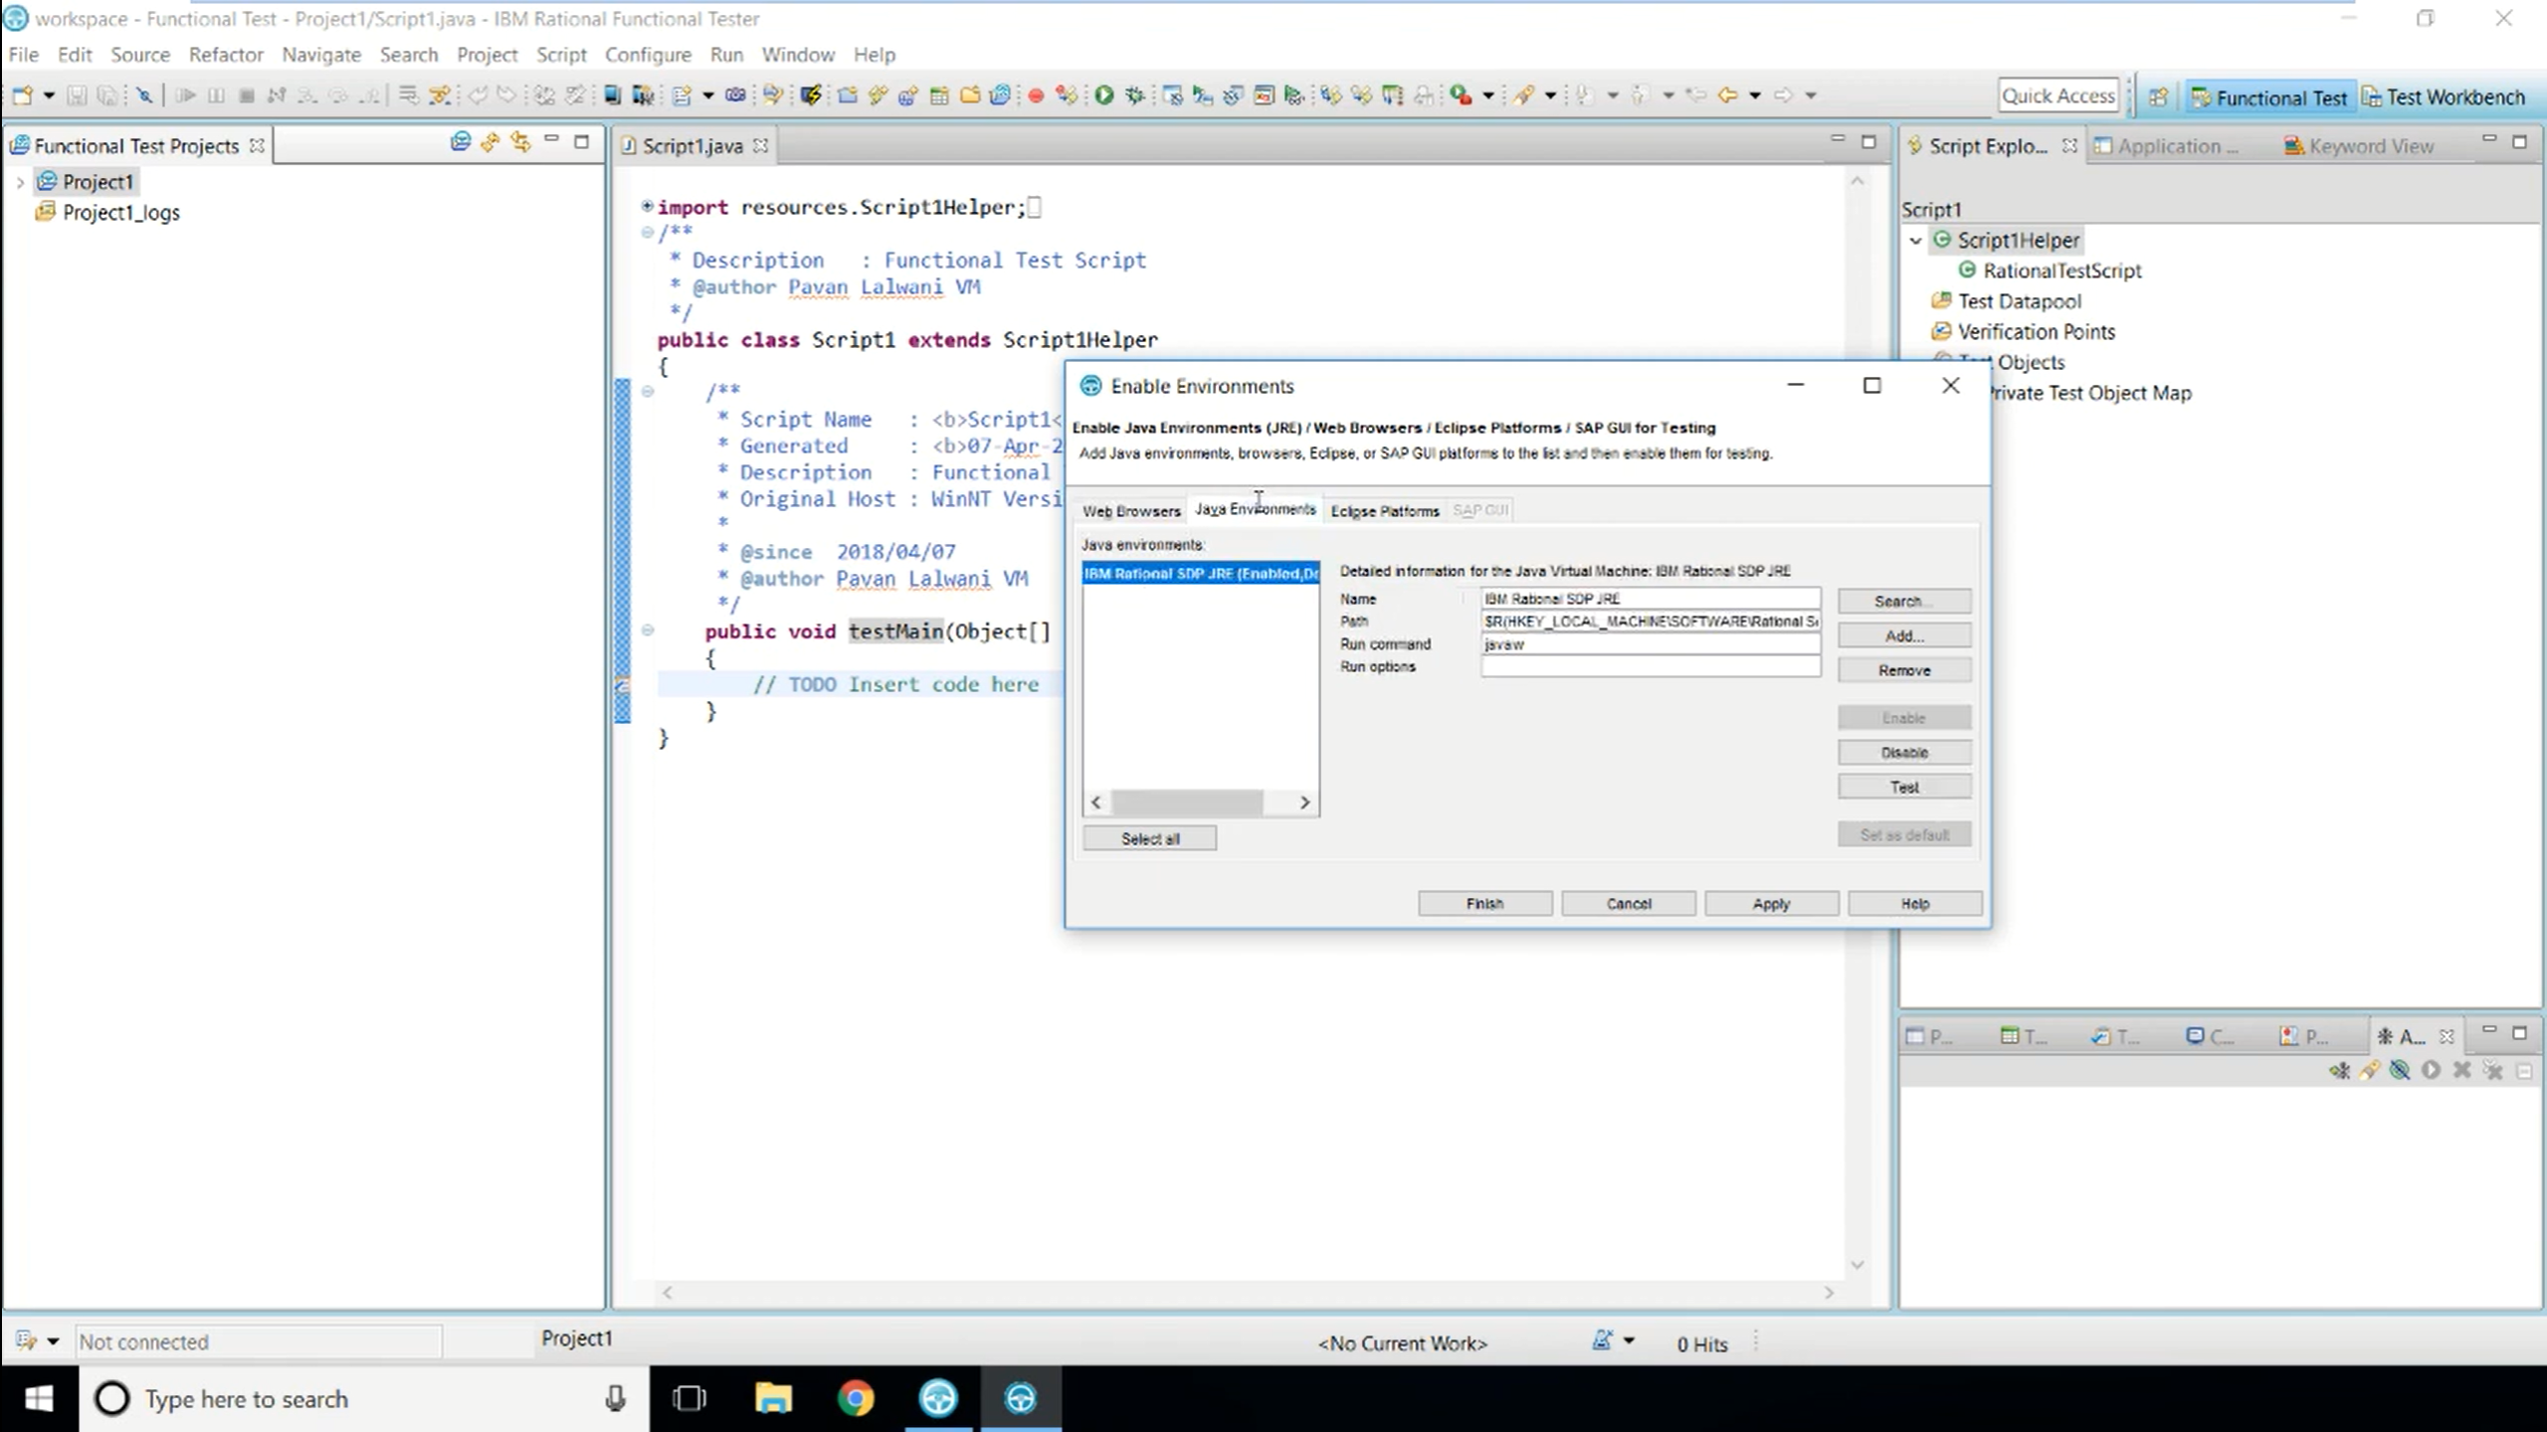

Slide 50
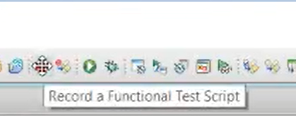
Record Sample Application

Slide 51
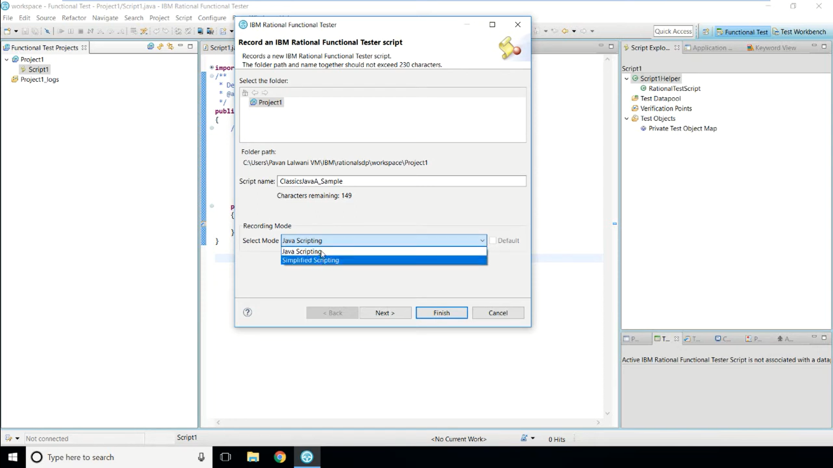

Slide 52
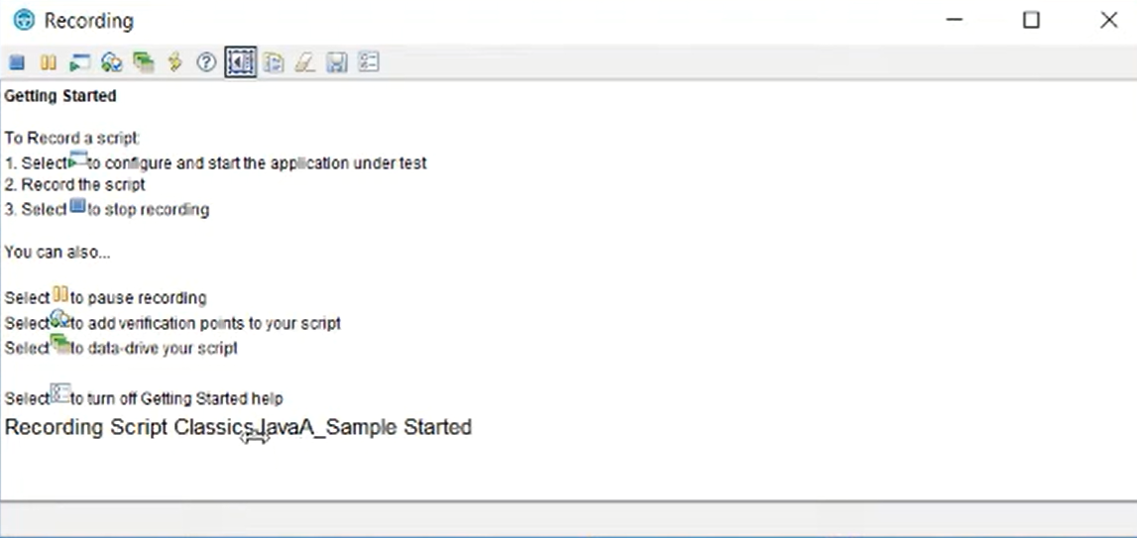
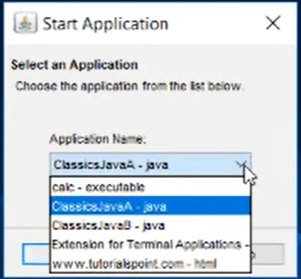
Start

Slide 53
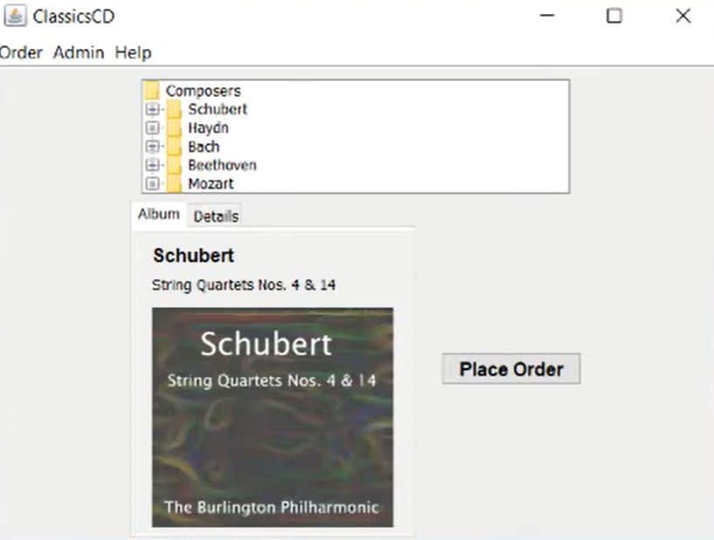
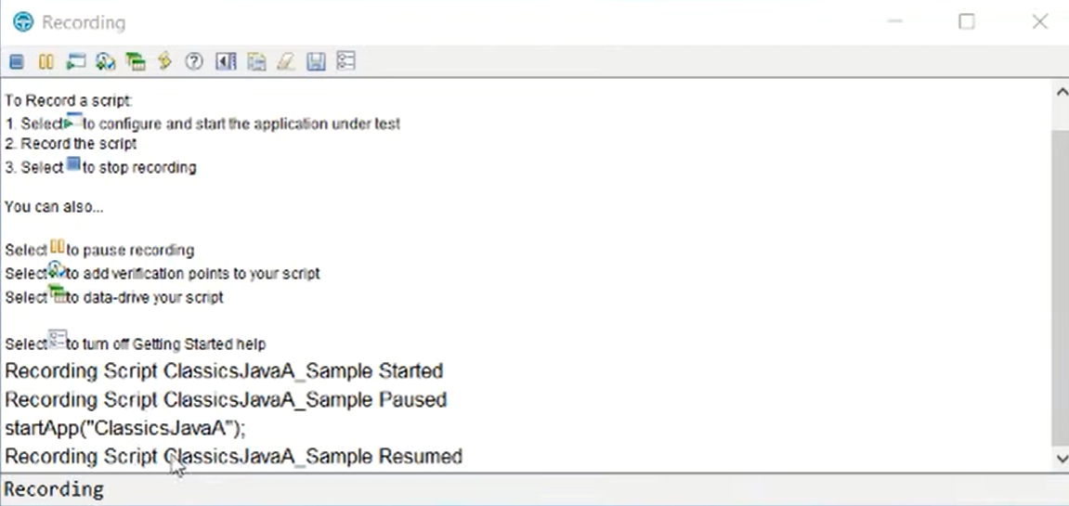

Slide 54
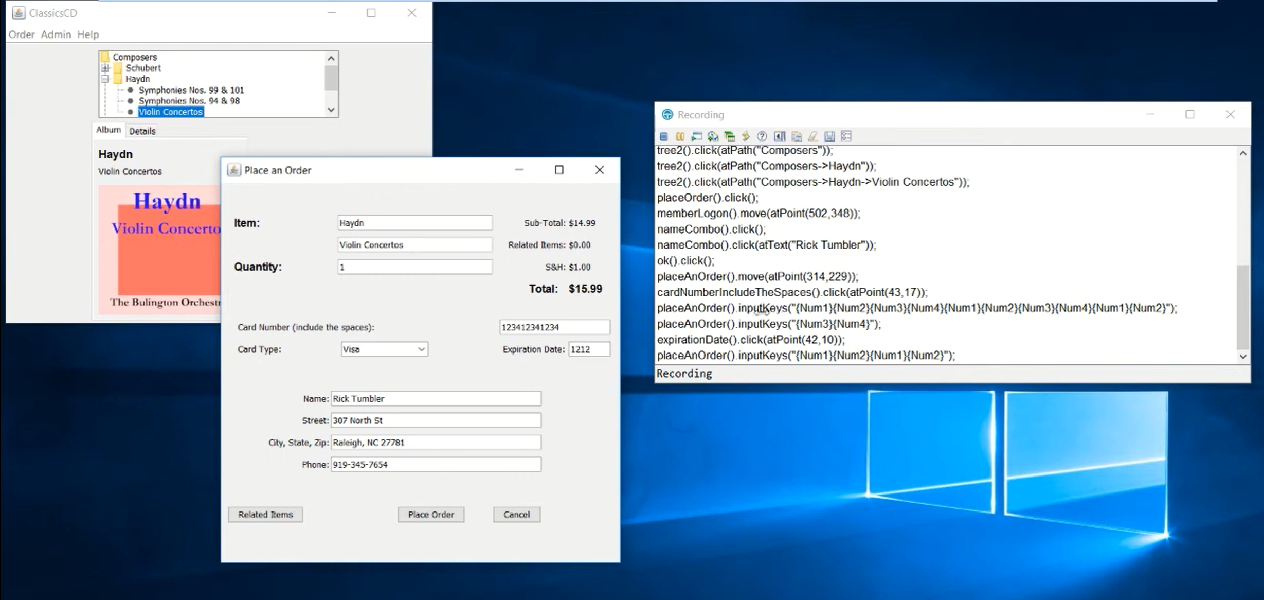
Once done click on
stop recording

Slide 55
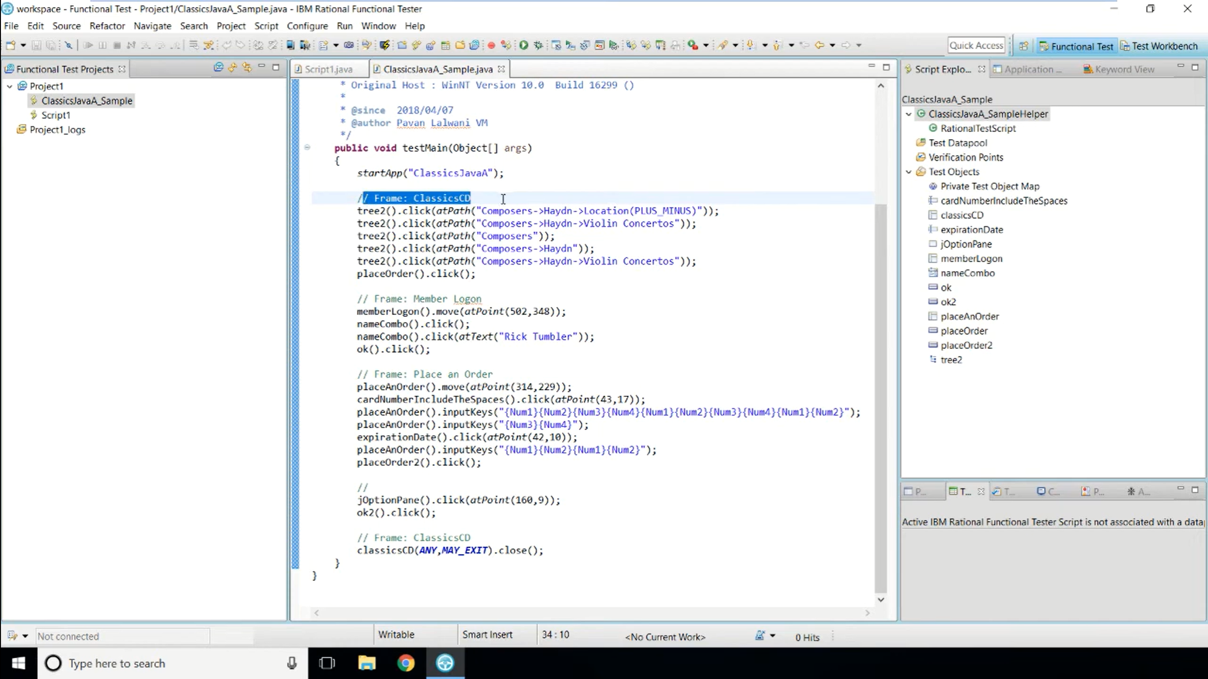

Slide 56


Slide 57


Slide 58


Slide 59


Slide 60

Log File

Slide 61


Slide 62

All the times mentioned here will be multiplied by 30

Slide 63


Slide 64
Playback Options
Playback Settings
Logging
Mouse Delays
Other Delays

Slide 65
Text
HTML
TPTP (Test & Performance Tools Platform)
XML
JSON

Slide 66


Slide 67


Slide 68


Slide 69


Slide 70


Slide 71


Slide 72


Slide 73
Insert Recording into Script
How can i correct a recording mistake?
How can I pickup where I left off when recording was interrupted?
How can I test a new AUT(Application Under Test) feature without rerecording the whole script?

Slide 74

Create
New Recording

Slide 75

Consider keep this window/screen open
If you stop recording?

Slide 76


Slide 77


Select
By Keeping cursor here

Slide 78


Slide 79


Slide 80

Script Support Functions

Slide 81

Start New Recording

Slide 82

Without starting
The script, select
Script support
Functions option

Slide 83


Slide 84


Slide 85


Slide 86


Slide 87


Slide 88

Script Timer In Function
Start New Recording

Slide 89


expand

Slide 90


Slide 91


Slide 92


Slide 93


